Slide 1

Cloud Native Governance + Security Workshop
Kevin Harris ( @kevbhar): Kevin.Harris@Microsoft.com
Dave Strebel ( @dave_strebel): Dave.Strebel@Microsoft.com

Slide 2
Agenda
Day 1
9:00am - 10:30 - Intros, Expectations, Customer Scenario, Security + Governance, Cluster Design, Pre-Provisioning
10:30am - 11:30am - Pre Provisioning Setup & Discussion (Hands-on)
11:30am - Noon - Cluster Provisioning
Noon - 1pm - Lunch
1pm - 2:00pm - Cluster Provisioning Setup & Discussion (Hands-on)
2:00pm - 2:30pm - Post-Provisioning
2:30pm - 3:00pm - Post-Provisioning Setup & Discussion (Hands-on)
3:00pm - 3:30pm - Cost Governance & Discussion (Hands-on)
3:30pm - 4:00pm - Application Deployment
4:00pm - 4:30pm - Application Deployment Setup & Discussion (Hands-on)

Slide 3
Agenda Cont.
Day 2
9:00am - 10:00am - Cont. Application Deployment Setup & Discussion (Hands-on)
10:00am - 10:45am - Day 2 Operations
10:45am - Noon - Day 2 Operations Setup & Discussion (Hands-on)
Noon - 1pm - Lunch
1:00pm - 1:30pm - Service Mesh
1:30pm - 2:00pm - Service Mesh Setup & Discussion (Hands-on)
2:00pm - 3:00pm - Validation Scenarios & Discussion
3:00pm - 4:00pm - Thought Leadership
4:00pm - 4:30pm - Wrap-up

Slide 4
Introductions, Expectations & Why?

Slide 5
Introductions
Who are you?
What do you do?
What do you want to get out of this workshop?
What are you currently struggling with around AKS?

Slide 6
Setting Expectations
NOT an Introduction to Containers, Kubernetes & AKS
Targeted at Highly Regulated Customers (ie. Financial Services, Insurance)
Familiarity with Azure & Completed AKS Workshop or have some experience with AKS (ie. Not the first time using Kubernetes)
Have a target Application Workload that needs to move into Azure + AKS
Will be Hands-on & Discussion
Provide Feedback
Content is “Not Comprehensive”, but a representative sample
Content is “Opinionated”, but not meant to be “Set in Stone”

Slide 7
Targeted Audience
Security/Risk Lead
Compliance Lead
InfoSec Lead
Identity & Access Mgmt Lead
Networking Lead
Cloud Engineering Lead
Line of Business Owner

Slide 8
Why?
Governance + Security is a Hot Topic
Top of mind for many Enterprise Organizations
Something repeatable for Customers and the Field
A place to Start
Lots of Questions???

Slide 9
Questions?
Can I put AKS in an existing VNET?
How do I best secure the cluster?
Can I lock down/restrict public endpoint?
How do I securely expose a service to Internet?
Can I control egress traffic out of the cluster?
Can I restrict traffic flow within the cluster?
Do I have another option besides storing k8s secrets?
How do I lock down/restrict access to File and Container Registry?
…..

Slide 10
Goals
Secure setup of AKS in Azure
How to apply Organizations’ Governance + Security Controls to AKS
Automation of Infrastructure, Changes & App Deployment
Understand Guidance around Running Apps Securely
Integration patterns using Service Mesh
Integration patterns for Secrets Mgmt

Slide 11
AKS Setup Before

Slide 12
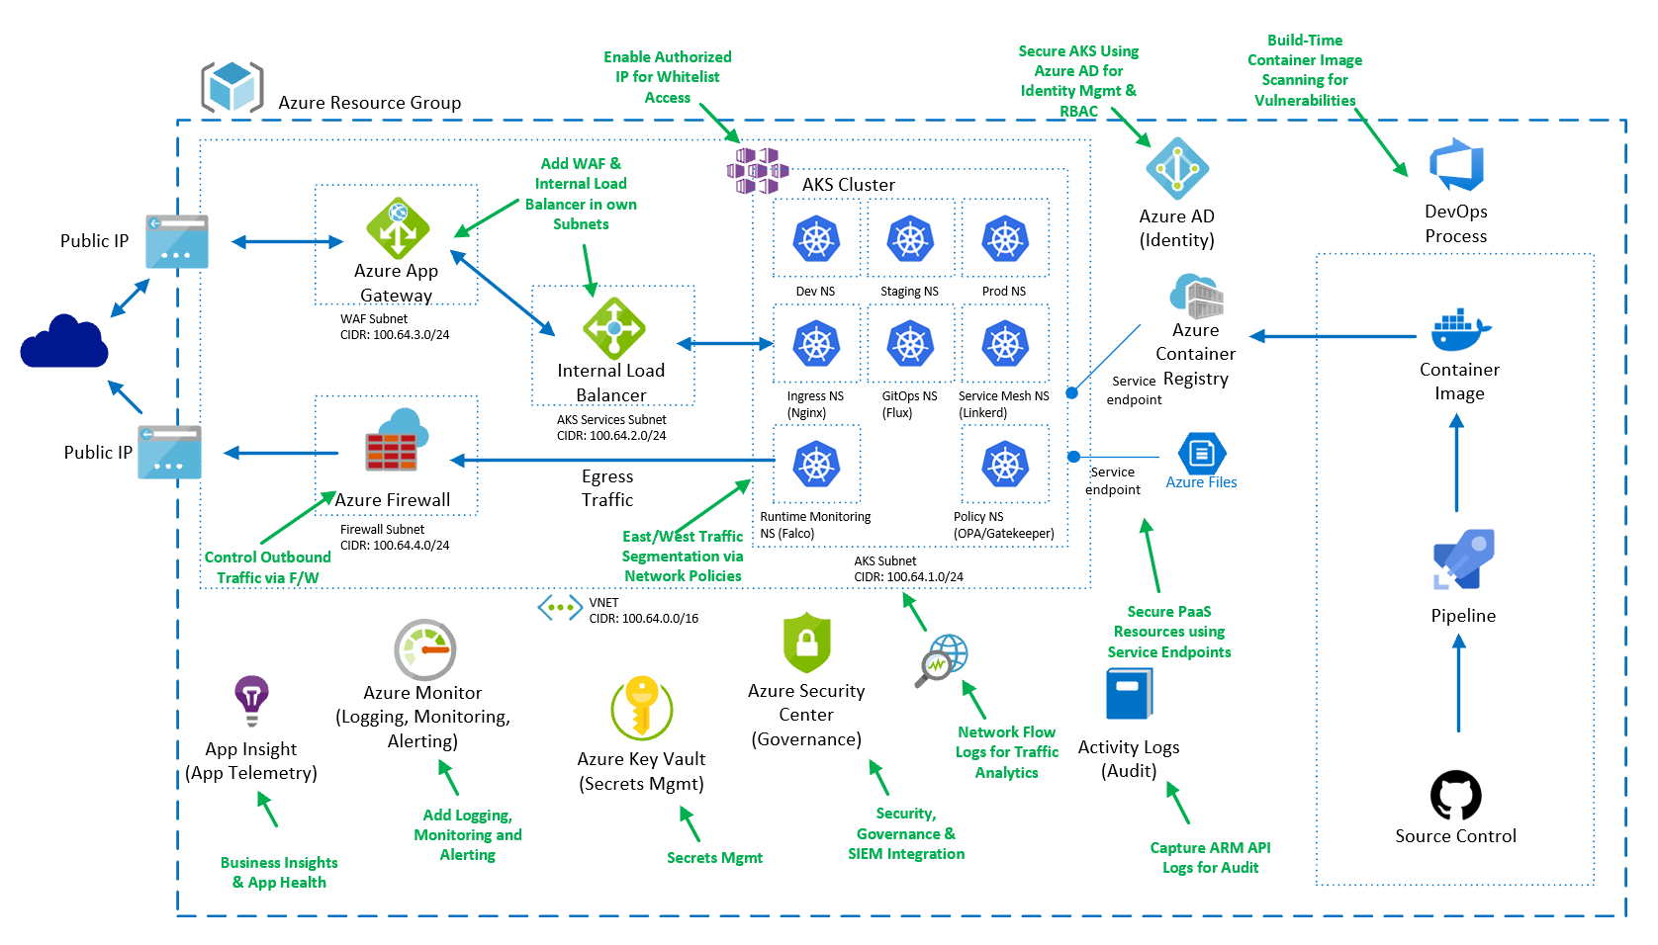
AKS Setup After

Slide 13
Introductions & Getting Started

Slide 14
Customer Scenario
Contoso Financial
Successfully completed Containers PoC with AKS & Want to move to Prod
15 Requirements that Need to be Met
https://github.com/Azure/sg-aks-workshop/tree/master/customer-scenario#requirements

Slide 15
Governance + Security Overview

Slide 16
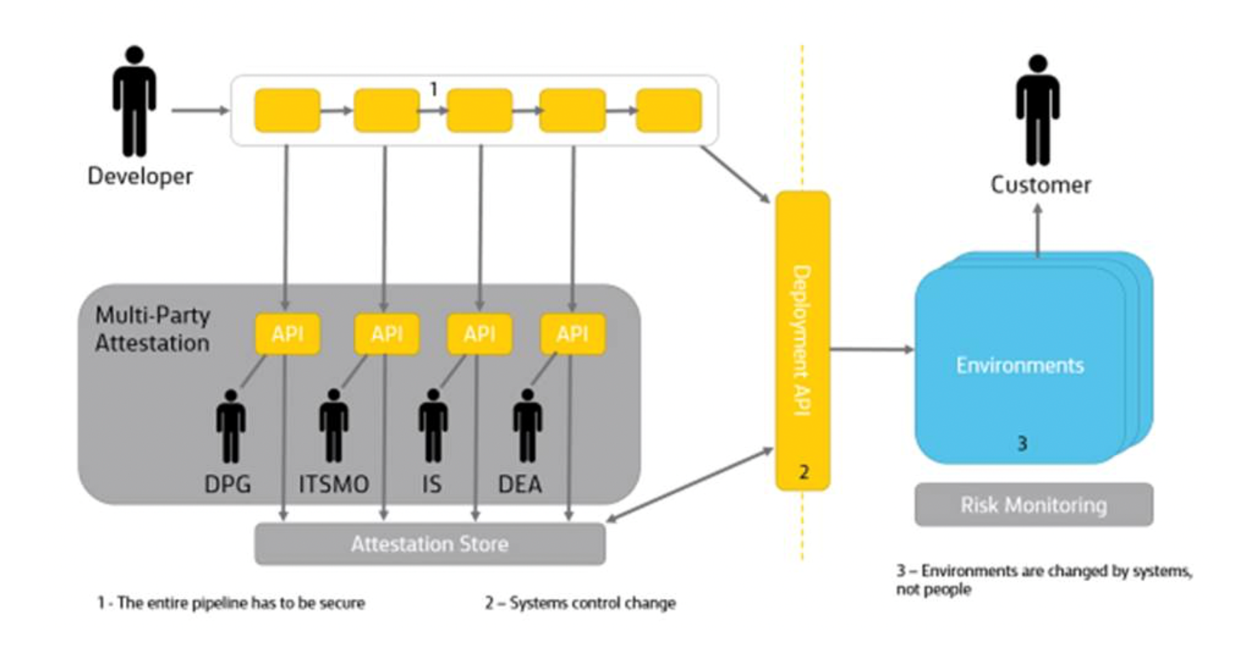
Governance + Security Overview
3 Themes
Roles + Responsibilities – Don’t just adopt what you are doing on-prem
Policy – Security Control Plane
Security as Source Control – Treat Security like Code & Infra as Code
Azure Specific Implementation

Slide 17
CSO Challenges
Security is their biggest concern when it comes to their company container strategy
Traditional security controls do not apply in the Cloud Native world
Manual configuration and controls
Network security controls (firewalls & IPS/IDS) fail to see container traffic
Reactive based security
We need to shift left and automate the security controls to withstand the container sprawl and their rate of churn.
Notes:
The key talking points are that you cannot take traditional security practices and apply them to the container ecosystem. Moving to a containerized and microservices architecture introduces many new container and Kubernetes security considerations, which existing security tools aren’t capable of properly addressing. Traditional Security is typically disconnected from the build pipeline, involves manual break point in the build process that impedes with the developer agility and leads to dealing with security after the fact.
A real world traditional model typically involves a developer working on a sprint and doing all the functional checks and checking the code in, and then moving to the next sprint. All the while the initial sprint is now sent to the Security team to assess the Security state of that sprint and then send findings back to the developer to remediate. At that point the developer has now moved on to other things which causes a delay in the remediation. On top of this, a Security resource had to manually assess the state and route the findings accordingly, which is time consuming and error prone. In other words traditional security is slow, process intensive and gate driven.
Modern app dev methodologies rely on continuous integration and continuous delivery (CI/CD) where security controls must be deeply embedded in the CI/CD pipeline for it to be effective, in other words DevSecOps is a MUST in a container world.
DevSecOps it is about having a process discussion and a tooling discussion. The overall value prop is about shifting security left and introducing automation into the build and release pipeline.
So taking the scenario above, a developer working on a sprint would now be responsible for functional testing as before, but also for security evaluation before the code can be checked in. Security Operations can define thresholds and controls, balancing the need for security with the developer need for speed. In the traditional model the Security Operations team would be responsible for triaging ALL vulnerabilities rather than making a decision about what to do with a vulnerability based on some criteria, such as the status provided by the vendor.
With shifting left, now the developers will be responsible on build for remediating a subset of vulnerabilities with a “Fixed” vendor status, leaving the Security Operations teams with the tasks of figuring out what to do with the rest, and how to avoid a drift after the build is checked in.
The new security mindset should expect security to start at the very beginning of the workload creation and through the DevOps process be automated, continuously improving with each subsequent iteration through the pipeline.

Slide 18
What do you need to consider?
Securing the CI/CD Pipeline (DevSecOps)
Docker image build best practices
Vulnerability detection
Compliance (Docker CIS)
Secret Management
Notes:
Container are not inherently insecure, but are deployed insecurely because the developers continuous quest for speed and agility. For this reason, a complete strategy for container security must cover the entire life cycle of containers from development to production and back to development for changes and improvements.
This will ensure that the container images you build are safe to deploy to production, they are free of vulnerabilities and that no one has tempered with them.
We start with making sure that the Docker image build follows best practices, involving things like Minimal OS, building images on Alpine vs. Ubuntu to minimize the attack surface, version control and integrity check. Also things like using COPY instead of ADD to bring content into the image in a secure way. These are just a couple of examples.
For Vulnerabilities, you want to talk about the ability to detect vulnerabilities at all stages of the lifecycle (build, registry, pod, host) and if possible, provide restriction capabilities like blocking an image on build, or from being deployed in the cluster because it has a vulnerability.
Compliance is important in the sense that a customer has a Kubernetes cluster that has to adhere to PCI compliance, and the developer builds an image running as root which would violate the PCI posture. It is much better from a flow perspective to kick that image back on build rather than deal with it during deployment or even worst after production deployment.
Secret Management is important as you don’t want developers posting passwords in plain text in the docker file in any way. It is a better practice to pass the password as an environment variable in secret, to reduce the attack vector. It is also important to recommend that the customer externalize the Secret Management like using Azure KeyVault instead of the Secret Management capability provided natively by the cluster. The reasons for that is because if ever the cluster is compromised so will be the secrets.

Slide 19
What do you need to consider? (continued)
Securing the Cluster
Pod security
Node security
Network security
Identity and RBAC
Cluster compliance (Kuberenetes CIS Bechmark, HIPPA, ISO 27001, etc.)
Kubernetes Audit Logging
Notes:
Kubernetes provides built-in security features to protect your identities, secrets, and network, and AKS builds on those features to further protect your workloads by leveraging the extensive security features offered by the Azure platform.
With AKS the master tier is hidden from the customer and secured by Azure. The main data points that need to be addressed from here is Node, Pod, and Network Security along with Identity.
Looking at Pod security it is about securing the app running in the pod. Essentially, it is Runtime security, meaning process, network, storage and syscall protection. It is also about resource isolation by making sure that resources are running within dedicated namespaces and that certain resources (such as storage volumes) are only accessible by certain processes.
Node security is about protecting the Kubernetes Worker Node from attack. There are a series of Kubernetes CIS benchmark checks specific to Worker Nodes that would be applicable here.
Although Network security is mentioned as part of the application security, another aspect of network security is L3 and L7 based attacks that need to be protected against. There are a couple of ways that network protection can be enabled to achieve L3 and L7 protection. Leveraging a Service Mesh such as Istio, Azure Gatekeeper, 3rd party solutions like Twistlock and others.
When looking at Identity the conversation is about utilizing Service Principals or Managed Identity within Azure to provide a secure way for Applications to access other Azure resources like Key Vault, or Azure blobs.
Enforcing compliance through the application of Kuberenetes CIS Bechmark for example or customer specific controls.
Enabling Kubernetes Audit Logs to be captured and processed by Azure Monitor or other monitoring solutions and used to investigate suspicious API requests, to collect statistics, or to generate alerts in case of unwanted API calls.

Slide 20
What do you need to consider? (continued)
Securing the Host
Vulnerability detection
Compliance (Linux CIS)
Host Runtime security
Notes:
Host Security is not a new concept for enterprises, the point here is to reinforce that in a container ecosystem the host running the Kubernetes cluster still needs to be maintained to close a privileged attack vector.
Ensuring the host is up to date, free of vulnerabilities and is adhering to Compliance best practices is still required and really is even more important in a container ecosystem because containers use a shared OS model and an attack on a vulnerability in the host OS could lead to a compromise of all containers.
We need to standardize on a shared OS kernel that is as small as possible to reduce the attack surface by removing unnecessary components and by hardening the host to established standards such as Linux CIS and continuously monitoring for unpatched vulnerabilities.
Rounding the security up with Runtime Security at the Host level will leave the customer with adequate security controls.

Slide 21
Contoso Financial "Pain" Points
Majority of IT operational tasks are not spent on moving business forward
Engineering perceived as "blocker" by Business units

Slide 22
What is Enterprise Control Plane (ECP)?
Organize Azure resources:
Management groups, subscriptions, resources groups and resources
Tags
Naming standards
Manage access to Azure resources:
Who has access and at what level ? RBAC and scope
Billing and Chargeback
Pass on the cost to application owners. Ensure the cost transparency.
Governance, security and compliance:
How are Azure resources deployed and configured?
How are Azure resources managed?
Monitoring and reporting:
Centralized view of Azure environment
Controls currency
Adopt Azure evolving features to enhance BMO Enterprise Control plane

Slide 23
Why Enterprise Control Plane (ECP)?
Application Platform Pipeline – Hit the Ground Running, Not from Scratch
Security Controls on Day 1 – Leverage work done with Security & Risk Teams
Observability – Ability to see which resources are not Compliant to assist with remediation
Identity & RBAC – Access Cloud Resources with a single Identity secured via RBAC
Monitoring & Logging – Centralized Monitoring & Logging to assist with Troubleshooting

Slide 24
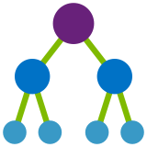



Enterprise Control Plane Architecture
Providing control over the cloud environment, without sacrificing developer agility
Environment factory Deploy and update cloud environments in a repeatable manner using composable artifacts
Policy-based control Real-time enforcement, compliance assessment and remediation at scale
Resource visibility Query, explore & analyze cloud resources at scale
Policy Definitions
Role-based Access
ARM Templates
Azure Portal
CLI
3rd party
Subscriptions
Management Groups
CRUD
Query
Azure Blueprints
Azure Resource Graph
Policy Engine
Azure Resource Manager (ARM)
Virtual Machine
Storage
Network
Resource Provider
Notes:
Lets take a look at how these services fit with each other:
Azure Policy sits on ARM, which means that you can apply policies to every service exposed to ARM.
Blueprints are built from ARM templates, so it is also engrained in the platform
Azure Resource Graph caches all the information from ARM rather than making calls every time you need information, making more efficient the exploration process
Management groups are a feature of the portal, which works along policies and blueprints to make subscription management and governance much easier to implement.

Slide 25
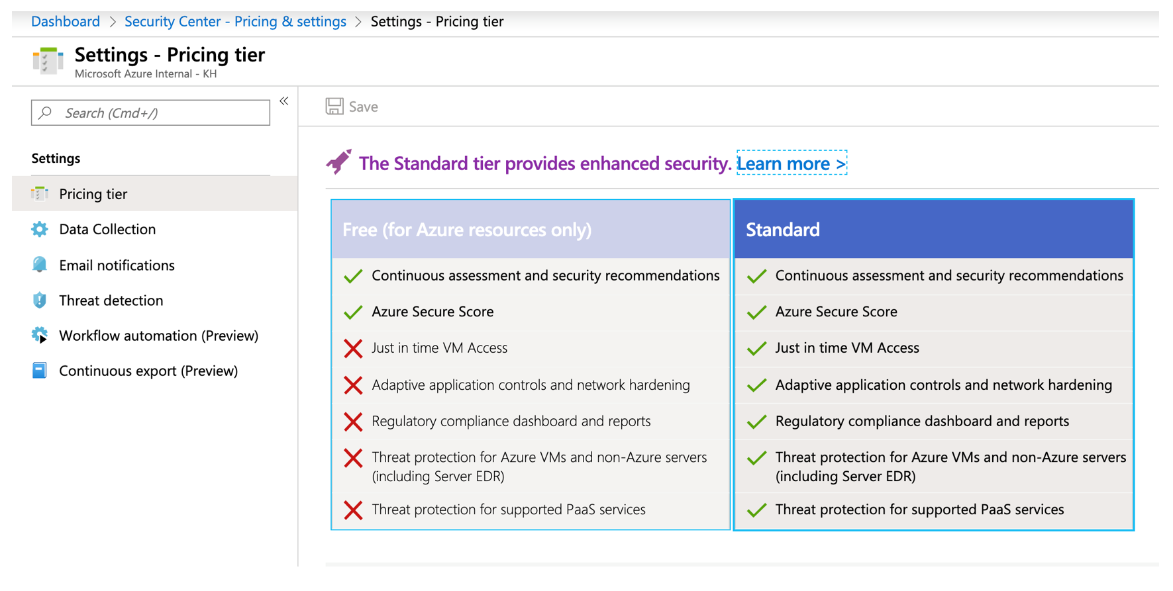
Azure Security Center
Notes:
- All about Cloud Posture

Slide 26
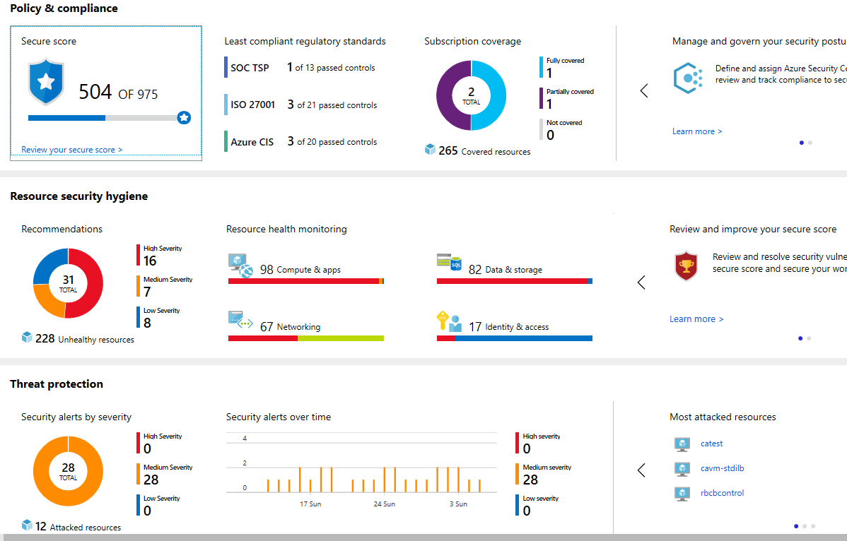
Azure Governance – Compliance
Overall # of Security Controls adhered to across all deployments.
Clear indicator how many Production Subscriptions are BMOcompliant.
Resource Count where security posture is no longer safe for BMO
BMO Resource Count actively attacked with low, medium or high severity.

Slide 27

Introducing Microsoft Azure Sentinel
Cloud-native SIEM for intelligent security analytics for your entire enterprise
Collect
Security data across your enterprise
Limitless cloud speed and scale
Bring your Office 365 data for Free
Easy integration with your existing tools
Faster threat protection with AI by your side
Respond
Detect
Rapidly and automate protection
Azure Sentinel
Threats with vast threat intelligence and AI
Investigate
Critical incidents guided by AI
Notes:
That’s why we re-imagined the SIEM + SOAR tool to introduce a new cloud-native solution called Microsoft Azure Sentinel - providing intelligent security analytics at cloud scale for your entire enterprise.
Azure Sentinel makes it easy to collect security data across your entire hybrid organization from devices, users, apps, servers and any cloud, it uses the power of artificial intelligence to ensure you are identifying real threats quickly, and unleashes you from the burden of traditional SIEMs by eliminating the need to spend time on setting up, maintaining and scaling infrastructure.
Since it is built on Azure, it offers limitless cloud scale and speed, scaling automatically to address your needs.
Traditional SIEMs have also proven to be expensive to own and operate, often requiring you to commit upfront and incur high cost for infrastructure maintenance and data ingestion. With Azure Sentinel there will be no upfront costs, you will only pay for what you use, and we are offering free Office 365 activity data import to help you reduce security costs significantly

Slide 28
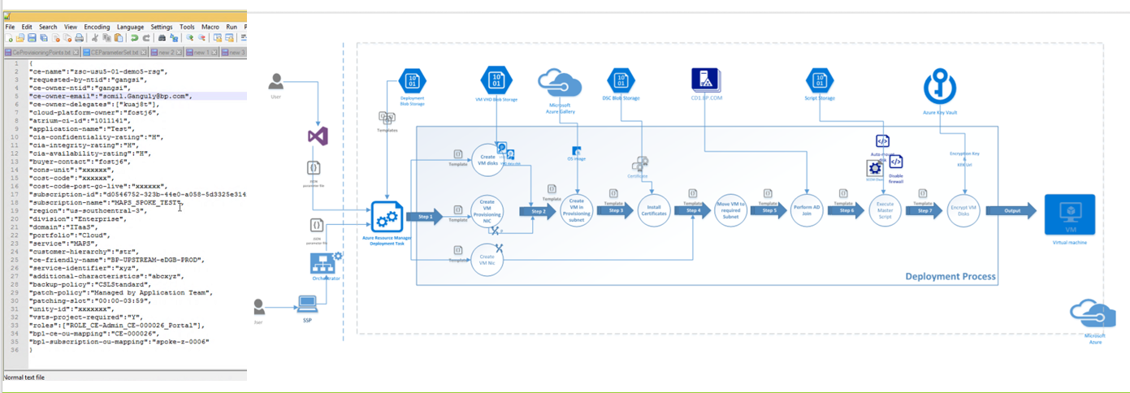
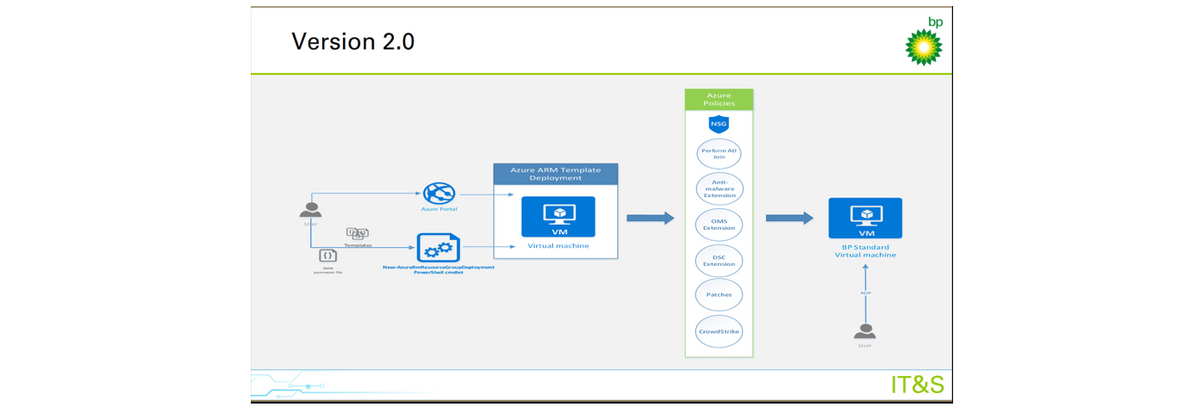
Azure Governance – In Practice
Before
After
Opened Azure Dashboard for use yet assured governed desired state.
Use of Azure Policies

Slide 29
Design Thoughts

Slide 30
Cluster Design
Tenancy – Coming Soon
Number of Clusters/Environments – Coming Soon
Networking Topology & Considerations
Secrets Mgmt

Slide 31

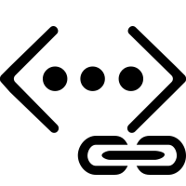
Scenarios enabled by Advanced Networking
Uses Azure subnet for both your containers and cluster VMs
1
On-premises infrastructure
3
Azure VNet A
Enterprise system
Allows for connectivity to existing Azure services in the same VNet
Backend services subnet
AKS subnet
Azure Express Route
AKS cluster
SQL Server
Use Express Route to connect to on-premises infrastructure
Azure SQL PaaS DB
5
Use VNet peering to connect to other VNets
2
Service Endpoint
Connect AKS cluster securely and privately to other Azure resources using VNet endpoints
VNet peering
Other peered VNets
4
AKS VNet integration works seamlessly with your existing network infrastructure

Slide 32
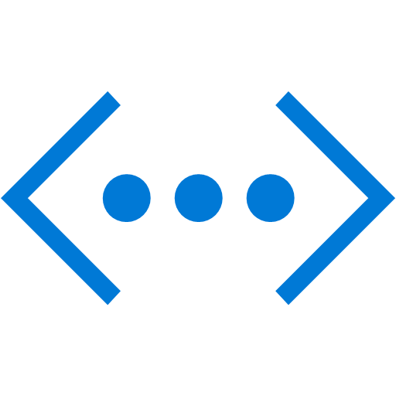
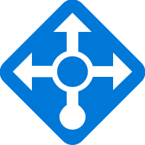
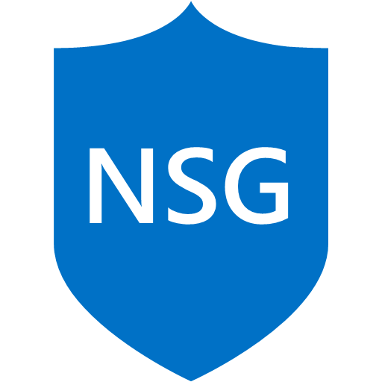
Public Service
Service Type LoadBalancer
Basic Layer4 Load Balancing (TCP/UDP)
Each service as assigned an IP on the ALB
Azure AKS VNet
Public IP
apiVersion: v1
kind: Service
metadata:
name: frontendservice
spec:
loadBalancerIP: X.X.X.X
type: LoadBalancer
ports:
- port: 80
selector:
app: frontend
Public LB
AKS subnet
AKS cluster
FrontEndService
Pod1 label:Frontend
Pod2 label:Frontend
Pod3 label:Frontend
Notes:
Now, lets say that you have a web application and it needs to be exposed to the internet
You will typically use the service Object in K8s
In Azure you can change the Service Type to Loadbalancer and we will create a loadblancer for you and assign a front end IP address which will handle routing the traffic from the outside to the cluster, then the service will take over
More service we will add more FIP to the LB
You can also assign a static IP to the service by specfiing the LoadBalancerIP parameneter in your service definition
On the diagram, traffic from the internet to the ALB, which in turn will send traffic on the cluster, there the service will take over and it will perform round robin on the pods
K8s services support basic layer 4 TCP/UDP load balaning

Slide 33
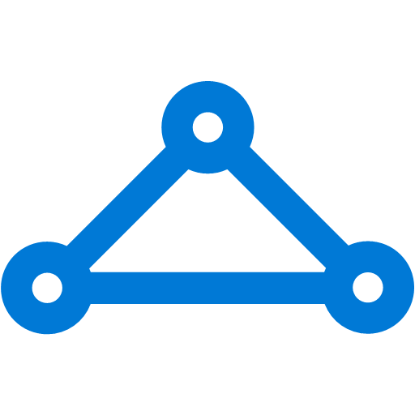
Internal Service
VNet B
On-premises infrastructure
Other peered VNets
Enterprise system
Used for internal services that should be accessed by other VNETs or On-Premise only
VNet peering
Azure Express Route
apiVersion: v1
kind: Service
metadata:
name: internalservice
annotations:
service.beta.kubernetes.io/azure-load-balancer-internal: "true"
spec:
type: LoadBalancer loadBalancerIP: 10.240.0.25
ports:
- port: 80
selector:
app: internal
Azure AKS VNet
Internal IP
Internal LB
AKS subnet
AKS cluster
InternalService
Pod1 label:Internal
Pod2 label:Internal
Pod3 label:Internal
Notes:
Now assuming that you have an internal application which needs to be accessed only from your other VNETs or On-Prem
You will use the same definition as before, but in this case you will have an annotation that instructs azure to spin up an internal LB
The IP for the service will be assigned from your VNET
Traffic flow is the same, other vnet to IP, then to service

Slide 34
Ingress
On-premises infrastructure
Enterprise system
kind: Ingress
metadata:
name: contoso-ingress
annotations: kubernetes.io/ingress.class: ”PublicIngress"
spec:
tls:
- hosts:
- contoso.com
secretName: contoso-secret
rules:
- host: contoso.com
http:
paths:
- path: /a
backend:
serviceName: servicea
servicePort: 80
- path: /b
backend:
serviceName: serviceb
servicePort: 80
Azure Express Route
Azure AKS VNet
Private IP
Public IP
Public LB
Internal LB
AKS subnet
AKS cluster
PublicIngress
PrivateIngress
contoso.com/A
contoso.com/B
serviceC.contoso.com
ServiceA
ServiceB
ServiceC
Notes:
In this example I have an Ingress object for domain contoso.com, on contoso.com I have 2 services A and B and I need SSL termination
So I have the TLS parameter and I’m referencing a secret holding my TLS cert
Then I start defining the rules, if traffic Is hitting the /a then route to the service name sevicea and the same for serviceb
You can have this as subdomain based as well, like a.contoso.com and b.contoso.com both can be done using ingress
But now this is a service that is exposed to the public, what If I need another service for internal access only, you can spin up another ingress controller in your cluster and expose it as internal, but note the class parameter which is used to tell which controller is responsible for which traffic
Also note that now you’re saving on Public IPs as you only need one for the ingress controller, and all other service can be exposed as clusterIP

Slide 35
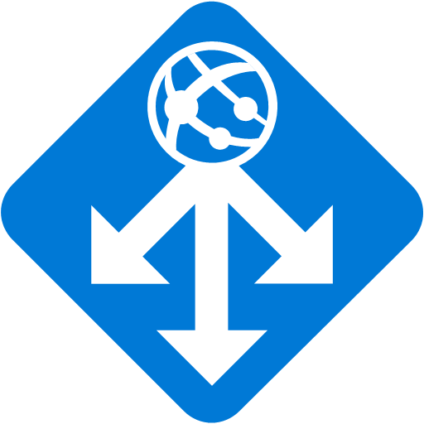
Securing Kubernetes Services with WAF
Azure Management VNET
APP GW Subnet
Azure AKS VNet
VNet peering
Private IP
AKS subnet
Internal LB
AKS cluster
Ingress
contoso.com/A
contoso.com/B
service.contoso.com
ServiceA
ServiceB
ServiceC
Notes:
So now what if we need a WAF to protect our services
You can the same setup with ingress and internal services and have the internal loadbalancer as the backend for APP GW
But in another subnet or VNET you can have Azure Application GW, which is a WAF that support OWASP 3.0 and 2.9.9 rule sets
You can also Terminate SSL on the APP GW and have advanced routing mechanisms
Now some are wondering why would I need Ingress in this case, you will need it if you need to secure the communication between APP GW and Ingress using SSL, and if you have the need to do the routing from the ingress itself

Slide 36
Advanced networking: Planning IP addressing for your cluster
Azure VNet
Frontend
Data tier
AKS
Subnet
1565
(> /21)
App tier
50
(50 * 30)
15
Additional subnets
Kubernetes service address range
Non-overlapping with other subnets in your network (does not need to be routable) and not 169.254.0.0/16, 172.30.0.0/16 and 172.31.0.0/16.
Smaller than /12
Docker bridge address
Non-overlapping with AKS Subnet

Slide 37
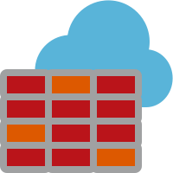
North/South Traffic in AKS with Firewall
L3-L7 Connectivity Policies
Target FQDN Examples
*.azmk8s.io (Eg. *eastus.azmk8s.io) – API Server
aksrepos.azurecr.io – Microsoft Images
*mcr.microsoft.com – Microsoft Images
*security.ubuntu.com – Ubuntu Security Updates
login.microsoftonline.com - AAD
management.azure.com – Azure API
AKS Subnet
NAT, Network and Application traffic filtering rules allows Inbound/Outbound access
Firewall Subnet
AKS Subnet
Azure Firewall
NAT Rules
TCP Port 9000 and 443 for API server FQDN and IP Address
TCP port 443 for the above FQDNs
AKS Clusters
Azure to On-Prem traffic filtering
Traffic is denied by default
On-Premises

Slide 38
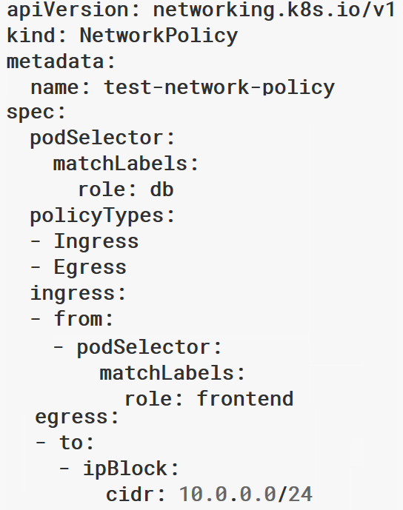

East/West Traffic in AKS with Network Policy
Recommend to create default policies that apply to all pods
Default deny all ingress traffic
Default deny all egress traffic
Allow Pod to Pod Communication in a Namespace
Allow Specific Traffic (Ingress & Egress) Across Namespaces
Kubernetes cluster

Slide 39
Node Management Through Azure Bastion
On-premises infrastructure
Azure Management VNET
Admin
Enterprise system
Azure Bastion Subnet
APP GW Subnet
Azure Bastion
Azure Express Route
Azure AKS VNet
VNet peering
Private IP
AKS subnet
Internal LB
AKS cluster
Ingress
contoso.com/A
contoso.com/B
service.contoso.com
ServiceA
ServiceB
ServiceC

Slide 40

Securing workloads – Azure Key Vault
Managing secrets and privileged information
Azure Key Vault
Flex Volume
Key Vault
AKS w/ RBAC
Azure Storage
SQL Database
Cosmos DB
Notes:
Enable low footprint integration, users shouldn't configure pods differently (example side cars) to allow this integration.

Slide 41
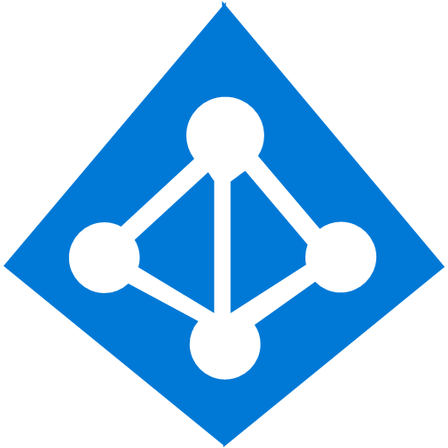
Securing Workloads - Pod Identity
Kubernetes operator defines an identity map for K8s service accounts
Developer
<\>
Node Managed Identity (NMI) watches for mapping reaction and syncs to Managed Service Identity (MSI)
Kubernetes
3
MIC Azure Identity Binding
Kubernetes controller
Azure SQL Server
Pod
1
Developer creates a pod with a service account. Pod uses standard Azure SDK to fetch a token bound to MSI
Active Directory Pod Identity
Token
4
Azure MSI
Pod uses access token to consume other Azure services; services validate token
NMI + EMSI
2
Notes:
Pod Identity requires two components:
Managed Identity Controller (MIC). A pod that binds Azure Ids to other pods - creates azureAssignedIdentity CRD.
Node Managed Identity (NMI). Identifies the pod based on the remote address of the incoming request, and then queries k8s (through MIC) for a matching Azure Id. It then make a adal request to get the token for the client id and returns as a response to the request. Implemented as a DaemonSet.

Slide 42
Cluster Pre-Provisioning

Slide 43
Pre-Provisioning Assumptions
Security Controls Decided & Some Implemented (e.g. Azure Policy)
Network Topology Decided
Service Principals Already Exist & With Appropriate Permissions

Slide 44
AKS Governance + Security Setup
Capture Azure Audit Logs Related to AKS
Enable Azure Security Center for AKS
Enable Azure Policy for Policy Enforcement (Allowed Regions)

Slide 45
Pre-Provisioning Setup
The virtual network for the AKS cluster must allow Ingress via the Internet as well as Egress to Internet connectivity.
Four Subnets
AKS - Cluster
Firewall – Egress Traffic
WAF – Ingress Traffic
Services Subnet – For Internal Load Balancers
The service principal used by the AKS cluster must have at least Network Contributor permissions on the subnet within your virtual network. If you wish to define a custom role instead of using the built-in Network Contributor role, the following permissions are required:
Microsoft.Network/virtualNetworks/subnets/join/action
Microsoft.Network/virtualNetworks/subnets/read

Slide 46
What is up with all these Service Principals?
Cluster Service Principal
To allow an AKS cluster to interact with other Azure resources, an Azure Active Directory service principal is used.
AD Integration Objects
When configuring Azure AD for AKS authentication, 2 Azure AD application are configured.
Server Application - used to get a users Azure AD group membership
Client Application - used when logging in with the Kubernetes CLI (kubectl
You can Rotate/Update them with:
$ az aks update-credentials --resource-group myResourceGroup --name myAKSCluster --reset-service-principal --service-principal $SP_ID --client-secret $SP_SECRET

Slide 47
To-Do
Read Customer Scenario & Understand Requirements
Implement AKS Governance + Security Setup
Implement Pre-Provisioning Setup (ie. Network)

Slide 48
Discussion
What worked? What didn't work?
Were steps/guidance missing? (ie. Is the content good enough or too much?)
Was there something in there you were expecting to see, but didn’t?
Are the customer scenario requirements hitting the mark?
Does the Azure Implementation of the Governance + Security controls make sense?
Do you agree with the network topology guidance?

Slide 49
Cluster Provisioning

Slide 50
Cluster Provisioning Assumptions
Network Exists
AAD Integration Decided & Service Principals Created (ie. Client & Server)
Azure RBAC Decided
GitOps Approach and Source Control Repository Layout Decided
Branch vs directory

Slide 51
Provisioning Setup
Don't create more than one AKS cluster in the same subnet.
AKS clusters may not use 169.254.0.0/16, 172.30.0.0/16, or 172.31.0.0/16 for the Kubernetes Service CIDR Range
Terraform + Flux pointing to Source Control (GitOps)
Setup Namespaces
RBAC
LimitRanges
Quotas
Network Policies

Slide 52
Provisioning Setup Cont.
Namespaces with RBAC, Quotas & Limits
Network Policies
Node Patching + Restarting – Kured
Policy Mgmt – OPA + Gatekeeper
Runtime Monitoring – Falco
Service Mesh – Linkerd
Pod Identity – Azure AD Pod Identity
Ingress Controller – Nginx
Logging + Monitoring – Azure Monitor for Containers

Slide 53
Cluster Provisioning Decisions
Common vs Cluster vs App Specific Services
Namespace Setup + RBAC
Ingress
Runtime Monitoring
Logging & Monitoring
Service Mesh or Not
AAD Pod Identity
Policy Controller
…

Slide 54
Cluster Level – Kubernetes RBAC and Azure AD integration
Kubernetes Developer authenticates with AAD
The AAD token issuance endpoint issues the access token
Azure Active Directory
Developer performs action w/ AAD token. Eg. kubectl create pod
1
4
<\>
Token
2
Kubernetes validates token with AAD and fetches the Developer’s AAD Groups Eg. Dev Team A, App Group B
Developer
3
AKS
5
Kubernetes RBAC and cluster policies are applied
6
Request is successful or not based on the previous validation

Slide 55

Azure Level - Kubernetes RBAC and Azure RBAC Roles
Kubernetes Administrator
Kubernetes Administrator authenticates with AAD
1
The AAD token issuance endpoint issues the access token
Azure Active Directory
Token
2
Administrator fetches the admin kubeconfig and configures RBAC roles and bindings
3
<\>
Token
Kubernetes Developer fetches the user kubeconfig
Developer
AKS
4

Slide 56
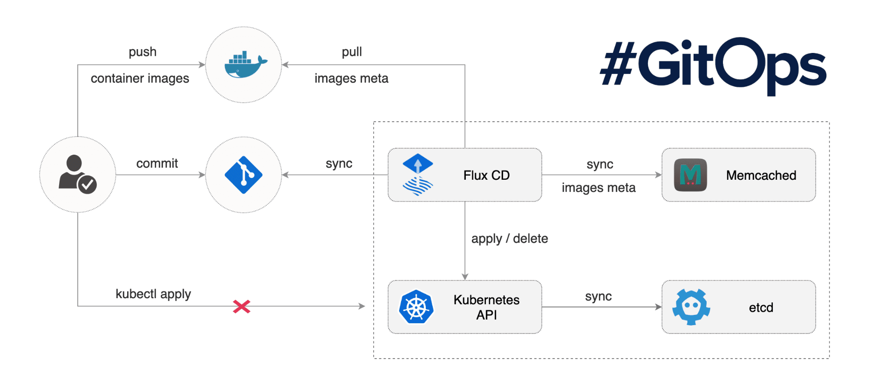
GitOps Approach
Notes:
For runtime enforcement, consider a process that deploys only those images that pass vulnerability scanning and those that adhere to the organization’s hardening policies. Kubernetes provides mechanisms to exercise such enforcement policies.
For remediation, ensure that the vulnerability scanning and security assessment function is integrated with the organization’s continuous integration/continuous deployment (CI/CD) pipeline. This way, the scanning results are fed directly to the pipeline, thereby kicking off remediation workflows before deployment. This should, in turn, be integrated with Kubernetes’ rolling updates feature, ensuring vulnerable containers are taken offline and replaced with freshly built images without the known flaws.

Slide 57



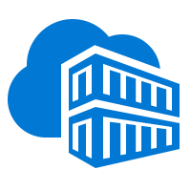


Container Level – Images and Runtime
Regularly apply security updates to the container images
Scan your images, scan your containers
Runtime enforcement and remediation
Trusted Registry
Aqua and Twistlock container security
AKS production cluster
Web tier
Azure Container Registry
Helm chart
Source code control
Azure Monitor
Aqua, Twistlock, Neuvector Container Security
Business tier
Auto-build
Azure Pipelines/ DevOps Project
Database tier
CI/CD
Notes:
For runtime enforcement, consider a process that deploys only those images that pass vulnerability scanning and those that adhere to the organization’s hardening policies. Kubernetes provides mechanisms to exercise such enforcement policies.
For remediation, ensure that the vulnerability scanning and security assessment function is integrated with the organization’s continuous integration/continuous deployment (CI/CD) pipeline. This way, the scanning results are fed directly to the pipeline, thereby kicking off remediation workflows before deployment. This should, in turn, be integrated with Kubernetes’ rolling updates feature, ensuring vulnerable containers are taken offline and replaced with freshly built images without the known flaws.

Slide 58
Policy controller
Admin adds policy for the cluster
Admin
User
Admin
Admin audits compliance of the cluster using /audit endpoint
3
Run audit
2
Create + Update
Policy as CRDs
1
User uses standard Kubernetes API to operate the cluster and the create actions are guarded by policy
kubernetes-policy-service
/admit
kubernetes-apiserver
4
Kubernetes-policy-controller provides an admission controller webhook that performs evaluations by calling open-policy-agent (OPA) service
/audit
/admit
watch
kubernetes-policy-controller
kubernetes-mgmt
audit
policy-admit
opa-admit
k8s object watcher
policy-crd-watcher
/query
/data
/policy
open-policy-agent

Slide 59
To-Do
Implement Cluster Provisioning Setup
Look at Namespaces Created
Make a Change to a Manifest in “cluster-config” folder of repo

Slide 60
Discussion
What worked? What didn't work?
Were steps/guidance missing? (ie. Is the content good enough or too much?)
Was there something in there you were expecting to see, but didn’t?
What namespaces were created? And what were their purpose?
Where can you see if there is any configuration drift?

Slide 61
Cluster Post-Provisioning

Slide 62
Post-Provisioning Assumptions
Cluster is now Created
Flux is Working Against Forked Repo

Slide 63
Post-Provisioning Setup
K8s Dashboard
K8s Audit Logs
ACR Permissions
Azure Monitor for Containers – Setup Cluster Metrics
Find Public IP of AKS api-server
Find Public IP of WAF (Azure Application Gateway)
Configure Gatekeeper Policies
Registry Whitelisting
Setup Flow Logs + Traffic Analytics

Slide 64
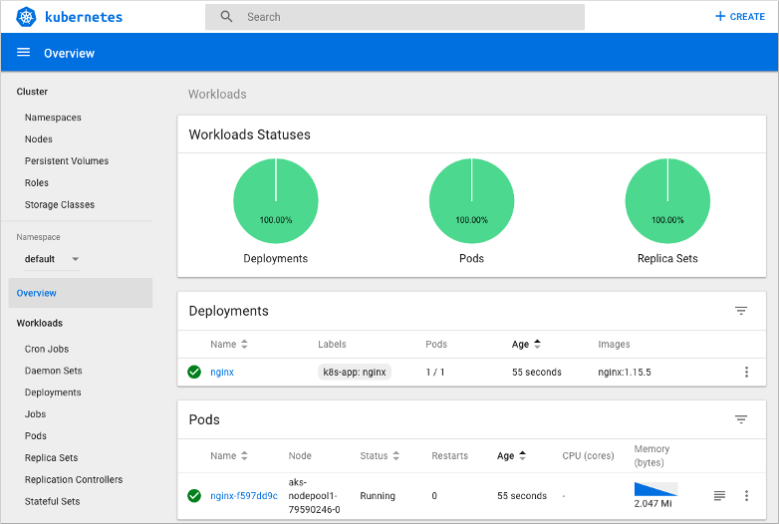
Kubernetes Dashboard

Slide 65
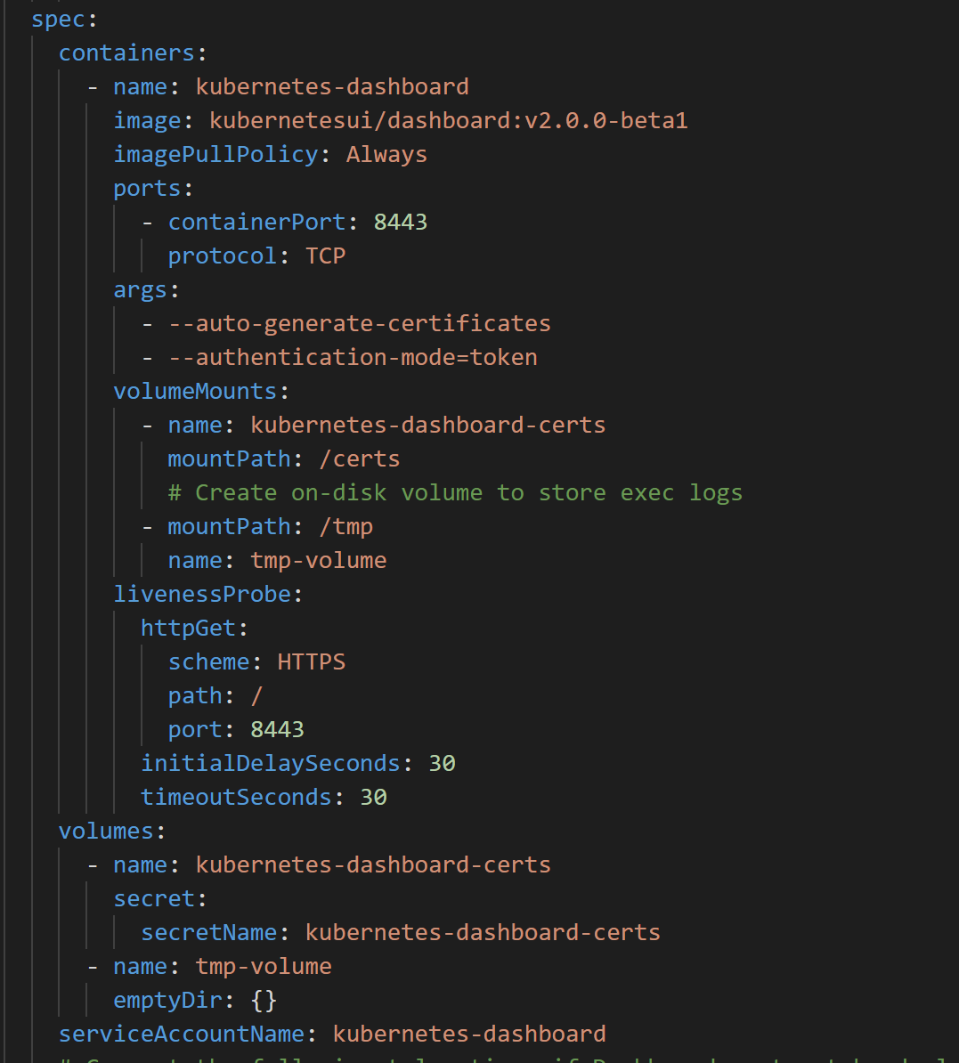
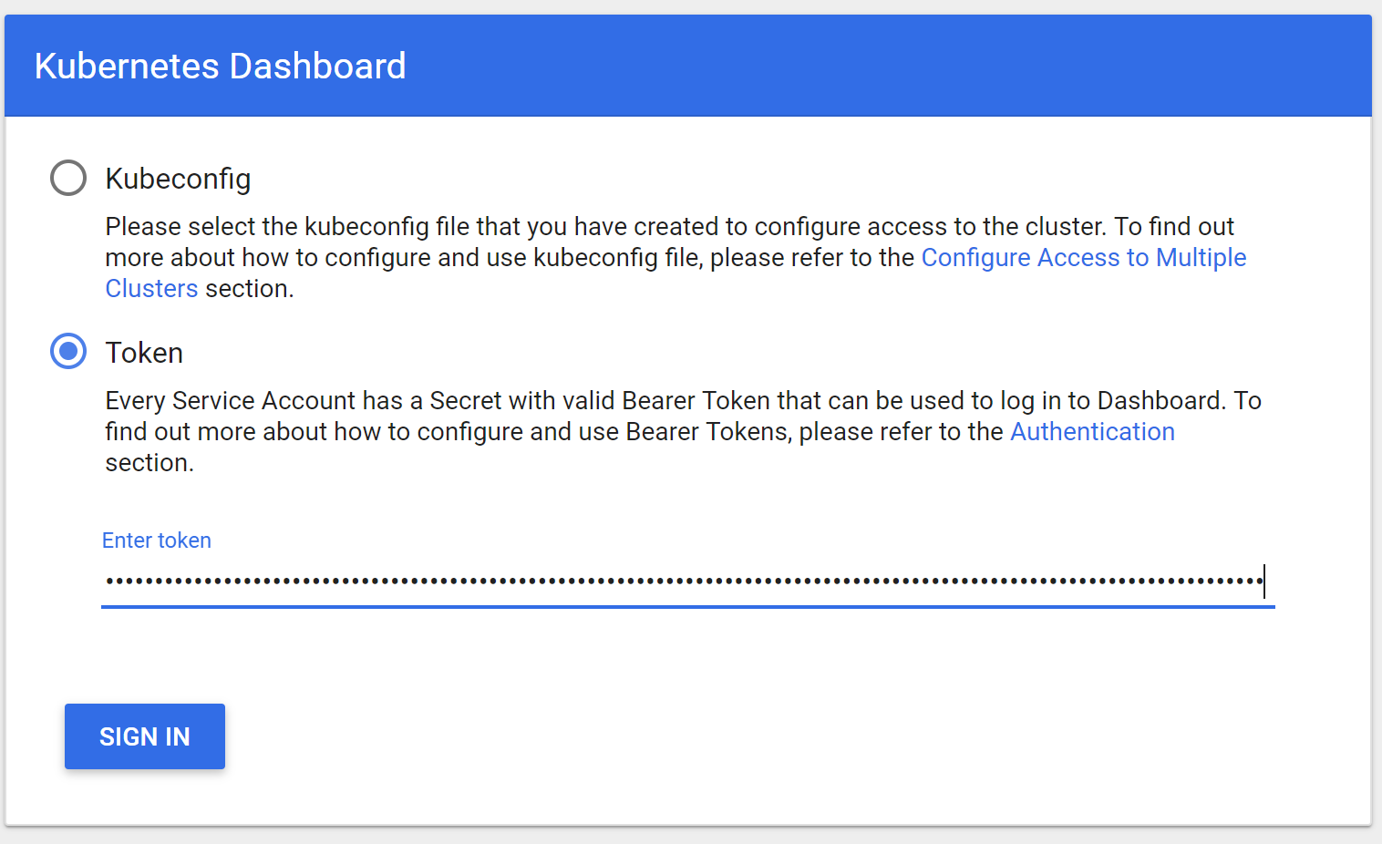
Kubernetes Dashboard – less worse

Slide 66
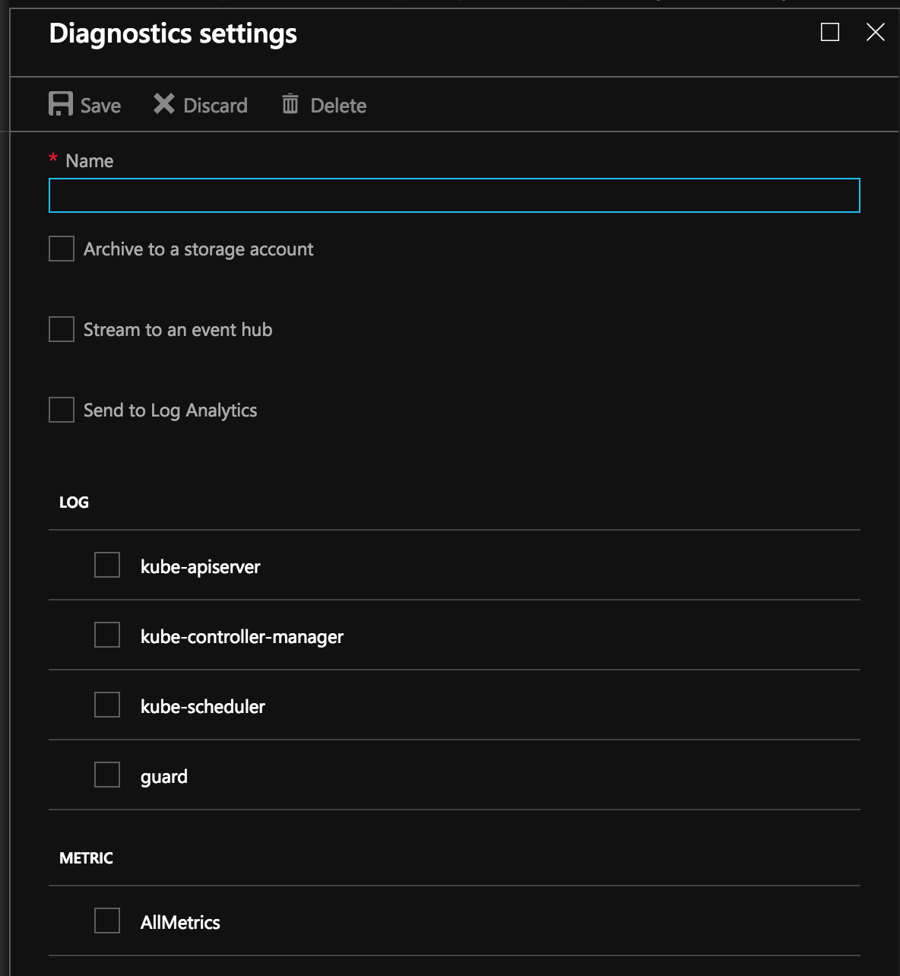
Enable Control plane logs
Use the Azure portal to enable diagnostics logs
Pipe logs to Log Analytics, Event Hub or a storage account
Metrics available today
kube-controller-manager
kube-api-server
kube-scheduler
Audit logs (new)

Slide 67



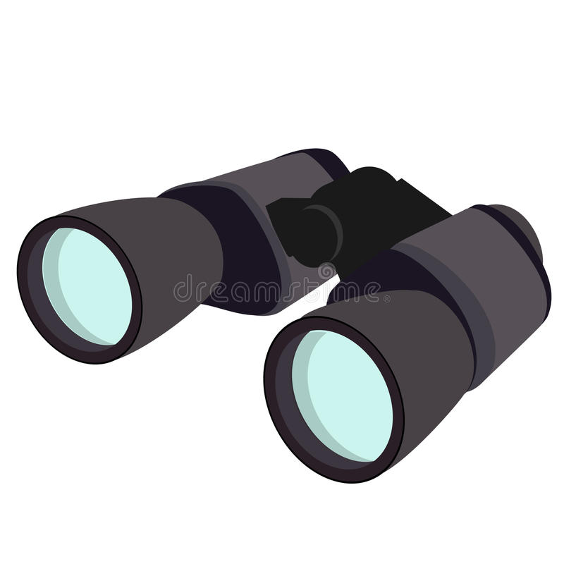



Azure Monitor for Containers
Cloud Native experience to Azure Monitor with Prometheus integration.
Observe live container logs and Kubernetes event log on container deployment status
Visualize overall health and performance from cluster to containers with drill downs and filters.
Insightful Monitoring
and Alerting
Visualization
1
Observability
2
Provide insights with multi-cluster health roll up view.
Insights
Azure Pipeline
Azure Kubernetes Service
Azure Monitor
for Containers
Monitor and analyze Kubernetes and container deployment performance, events, health, and logs
Monitor
Analyze
AKS Virtual Node
Native alerting with integration to issue managements and ITSM tools.
Response

Slide 68
ACR Permissions
No ImagePullSecrets
Leverage AKS Service Principal

Slide 69
Find Public IP Endpoints
AKS api-server – Needed for Authorized IP Ranges
WAF (Azure Application Gateway) – Ingress point for Ingress Controller and Application Workload

Slide 70
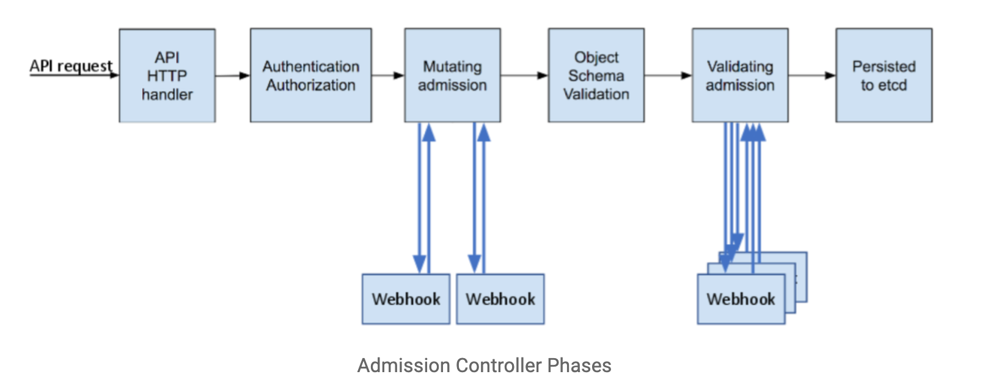

Slide 71
Dynamic Admission Control
Validating Webhook
Allows you to intercept and validate requests
Can be run in parallel, as they don’t mutate objects
Example use case: restricting resource creation
Mutating Webhook
Executes the mutation by sending requests to webhook server
Matching webhooks are called in serial
Example use case: injecting side cars
Policy Enforcement
Admission Control is policy based on Kubernetes objects.
Network Policy and PodSecurity Policy focus on data plane policy
RBAC is policy enforced on the user
Notes:
Talk more of what can Dynamic Admission controllers are and their use cases
; each one may modify the object if it desires

Slide 72

That’s awesome! But…
Notes:
So yes dynamic controllers are awesome, but they create a lot of custom code that has to be mainted and configured in Kubernetes

Slide 73
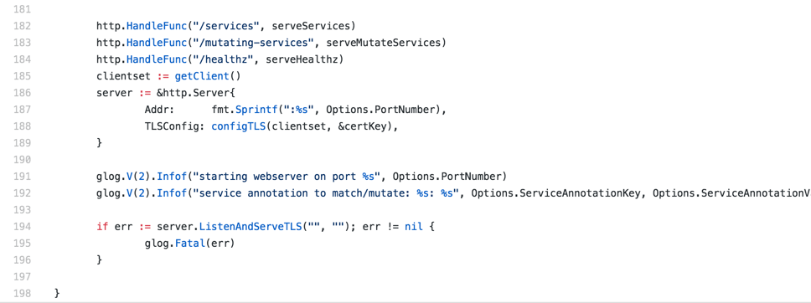
Sample Admission Webhook

Slide 74
Open Policy Agent
CNCF Hosted Sandbox Project
General purpose policy engine
Can be used across the stack
Declarative policy language (Rego)
Image: openpolicyagent.org
Notes:
Overview key features of the Open Policy Agent

Slide 75
Request
Service refers to:
Kubernetes API
Custom API
SSH Daemon
Terraform
Authorization APi
Service
Enforcement
Policy
Query
Policy
Decision
OPA
Input can be any JSON value:
"kind": "Service",
"metadata": {
"annotations": {
department: dev
}
Output can be any JSON value:
”true
”request annotated” “ “annotations": {
costCenter: 8000
}
Policy
(Rego)
Data
(JSON)
Diagram rewritten from: www.openpolicyagent.org
Notes:
More detail in how Open Policy agent makes enforcement decisions

Slide 76
Example Rego Policy
Rego is a policy language and not a programing language, so don’t think about sockets, methods, binary trees, etc.
Think about two things: Logic and Data
Rego logic is all queries. A query finds values for variables that make boolean conditions true.
You write logic to search and combine JSON/YAML data from different sources.
deny[{
"id": "conditional-annotation",
"resource": {"kind": kind, "namespace": namespace, "name": name},
"resolution": {"patches": p, "message" : "conditional annotation"}, }] {
matches[[kind, namespace, name, matched_object]] matched_object.metadata.annotations[”Mr-T"]
p = [{"op": "add", "path": "/metadata/annotations/cost-center", "value": ”A-Team"}] }
Notes:
Outline rego and a sample policy

Slide 77
Who manages all this policy?
Developer
Deploys Apps
Ice Kube
OPA Policy
Audits Platform
Platform Operator
Creates And Maintains
The Governor
Acid Burn

Slide 78
Kubernetes Policy Controller
Kubernetes Policy Controller
Moving to OPA org, as a standard Kubernetes Policy Controller
Authorization module makes it possible to implement a blacklist in front of RBAC
Provides auditing features
Deployment consist of three containers: OPA, kube-mgmt., and Controller
Examples:
Whitelist / blacklist registries.
Not allow conflicting hosts for ingresses.
Label objects based on a user from a department.
Block kubectl exec <pod>
Notes:
General Overview of of the Kubernetes Policy Management Controller

Slide 79
The Good, The Bad, and Gotchas
Good
OPA approach allows you to decouple policy from your applications
General purpose, so can be used outside of Kubernetes context.
Bad
There can be a learning curve to Rego.
Can cause latency, but’s negligible for most apps. (more of a consideration)
Gotchas
Mutating objects need to be handled with care. They can cause unexpected behavior to what the end-user expects.
Notes:
Talk about takeaways and what attendees learned and renforce how OPA\Policy controller solves the Problem from first few slides

Slide 80
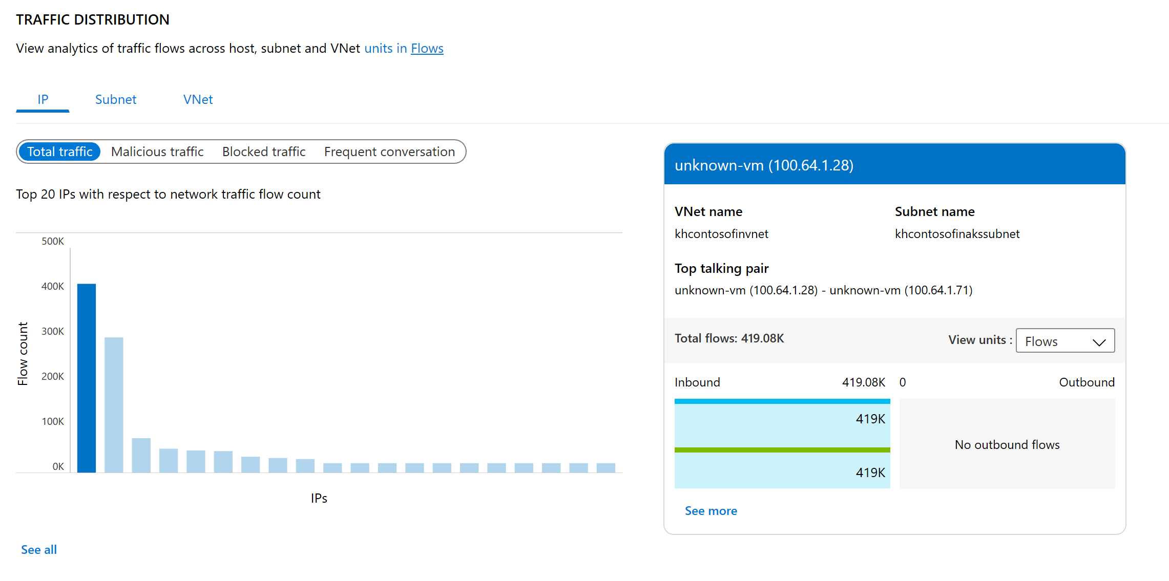
Traffic Analytics
View Ports and VMs Receiving Traffic from Internet
Find Traffic Hot Spots
Visualize Traffic Distribution by Geography
Visualize Traffic Distribution by Virtual Networks
Visualize Trends in NSG Rule Hits
…

Slide 81
To-Do
Implement Cluster Post-Provisioning Setup
Look at Traffic Analytics

Slide 82
Discussion
What worked? What didn't work?
Were steps/guidance missing? (ie. Is the content good enough or too much?)
Was there something in there you were expecting to see, but didn’t?
How else could these steps be done?
Could these steps have been done as part of the GitOps setup done in Cluster Provisioning?

Slide 83
Cost Governance

Slide 84
Cost Governance Assumptions
Chargeback is Needed
Chargeback Model Decided

Slide 85
Cost Governance Setup
KubeCost
Chargeback at different scopes
Effective Utilization of Cluster Resources
Notes:
- Can scope chargeback to a deployment, service, label, pod, and namespace

Slide 86
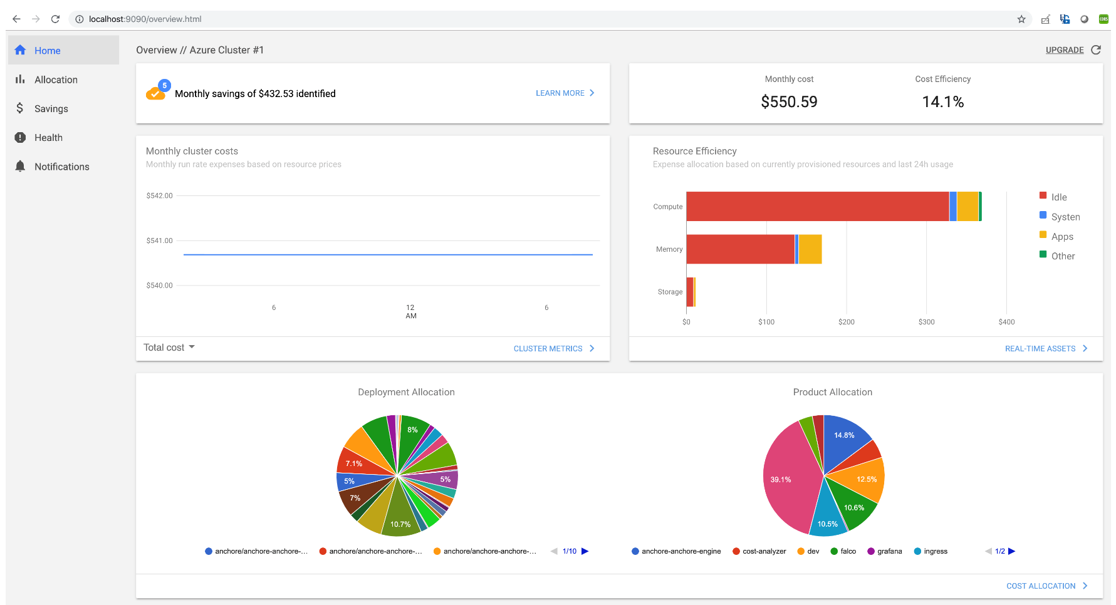
Kubecost Demo

Slide 87
To-Do
Implement Cost Governance Setup

Slide 88
Discussion
What worked? What didn't work?
Were steps/guidance missing? (ie. Is the content good enough or too much?)
Was there something in there you were expecting to see, but didn’t?
What else did Kubecost provide in addition to costing insights?

Slide 89
Application Deployment

Slide 90
Application Deployment Assumptions
Application Deployment Pattern Decided
Sensitive Information will be stored in Azure Key Vault
All Images will be scanned at Build-Time
Application Insights will be used for Application Performance Monitoring
Application Health Monitoring is Required

Slide 91
Application Deployment Setup
Quick Overview of App & Show It
Container Development – Inner DevOps Loop
Tilt
Telepresence
Azure Dev Spaces
Image Mgmt – Build-Time Scanning
Anchore
Deploy v1 App
Deploy Image Classification App to Dev Namespace
Deploy v3 App
Add Health Checks via Liveness and Readiness Probes
Add App Instrumentation with Azure Monitor Application Insights
Add Azure AD Pod Identity for Key Retrieval from Azure Key Vault

Slide 92
To-Do
Implement Application Deployment Setup

Slide 93
Discussion
What worked? What didn't work?
Were steps/guidance missing? (ie. Is the content good enough or too much?)
Was there something in there you were expecting to see, but didn’t?
What are the different options for doing Secrets Mgmt?
What did you notice when using AAD Pod Identity?

Slide 94
Day 2 Operations

Slide 95
Day 2 Operations Assumptions
Logging + Monitoring Solution(s) Decided
Patching + Rebooting Decided
Upgrade Strategy Decided

Slide 96
Day 2 Operations Setup
Logging + Monitoring
Resource Mgmt (Cluster Starvation, PDBs, Disk Space, CPU/Memory/Disk Utilization)
Metrics Alert(Disk Utilization)
Log Analytics Query Alert (SSH Into Container)
Patching + Rebooting
Upgrades
Cluster
Applications with NodePools

Slide 97
Cluster Level – Nodes, Upgrade and Patches
Regular maintenance, security and cleanup tasks
Maintain, update and upgrade hosts and kubernetes - Monthly ideal, 3 months minimum
Security patches
AKS automatically applies security patches to the nodes on a nightly schedule
You’re responsible to reboot as required, leveraging tools like Kured DaemonSet https://github.com/weaveworks/kured
Upgrade to new versions
$ az aks upgrade --name myAKSCluster \ --resource-group myResourceGroup \ --kubernetes-version 1.10.6
SSH Access
DenyEscalatingExec
Running benchmarks and tests to validate cluster setup
Kube-bench
Aqua Hunter
Others

Slide 98
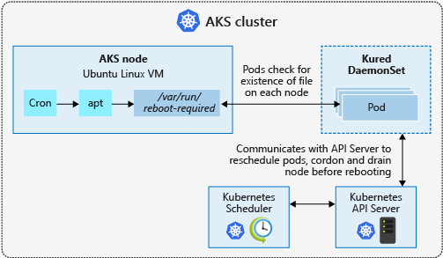
Process Node OS Security Patches
AKS automatically applies security patches to the nodes on a nightly schedule
You’re responsible to reboot as required
Regular maintenance recommended
Monthly ideal, 3 months maximum
Use Kured DaemonSet to watch for nodes requiring a reboot and handle the reschedule of the pods and reboot of the nodes. Check AKS documentation for guidance to use Kured

Slide 99
What to be careful when monitoring Kubernetes?
Workloads
Health, performance, SLA (create, start, end)
Restart counts
Crash loop
Workload Sizing and Tuning
noisy neighbor
limits/requests per workload – oversubscription
pod anti-affinity – distribution of containers among nodes
Cluster (Orchestrator) “itself”
etcd, kube-api, increasing pending pods can pause any deployment running
capacity – do I need to scale up/down?
Platform – Node, Network, Storage

Slide 100
To-Do
Implement Day 2 Operations Setup

Slide 101
Discussion
What worked? What didn't work?
Were steps/guidance missing? (ie. Is the content good enough or too much?)
Was there something in there you were expecting to see, but didn’t?
What did you find challenging around accessing the information to setup Alerts?
Was the information you were looking for easy to find?
What is the difference between a Metric and Log Alert?

Slide 102
Service Mesh

Slide 103
Service Mesh Assumptions
Service Mesh Needed is Decided
Service Mesh Capabilities Decided
Service Mesh Technology Decided

Slide 104
Service Mesh
Do I need one?
So “Why?” in the workshop?
Key Capabilities
Encrypt Traffic (Protect Data in Transit)
Canary and Phased Rollouts
Traffic Mgmt & Manipulation
Observability
Why Linkerd?

Slide 105
Organizations are rapidly adopting modern microservice architectures
~60% of organizations are running in production with microservice architectures in some fashion
~86% of companies expect microservices to be their default architecture within 5 years
n = 353
n = 322
Source: Dimensional Research, “Global Microservices Trends, A Survey of Development Professionals” (April 2018)

Slide 106
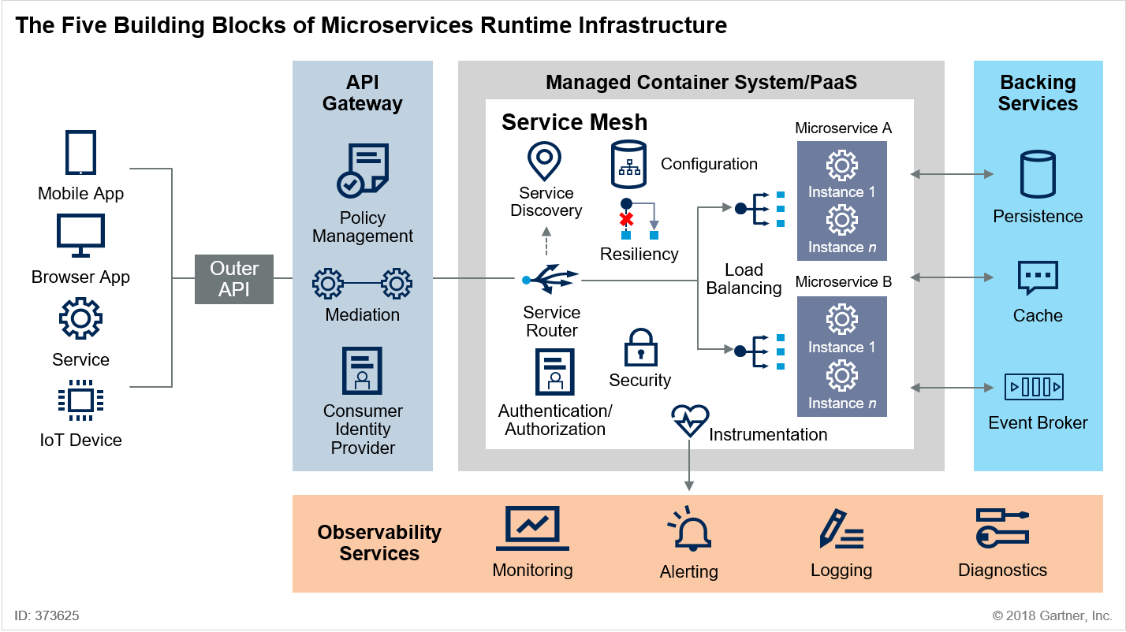
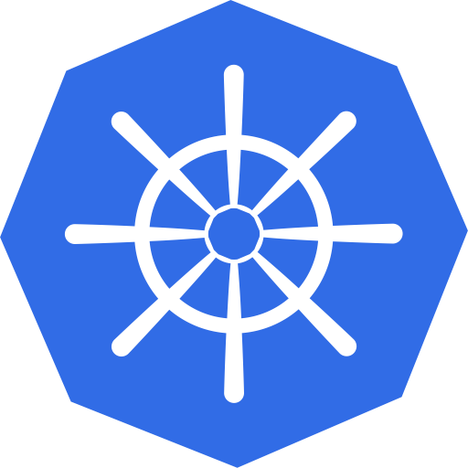

Service mesh overview
KEY OBSERVATIONS
Microservice applications are commonly deployed with containers, which are ephemeral, thus making microservice communications difficult
Service mesh’s primary use case is to manage service-to-service (east to west) communications within managed container clusters
By standardizing traffic management among different services, service mesh is standardizing app runtime operations
Service mesh benefits help with the availability, resiliency, scalability, visibility, etc.
Also enables uniform code changes, polyglot systems, and DevOps practices
Service mesh capabilities
Configuration
Observability
Instrumentation
Load balancing
Routing
Resiliency
AuthN / AuthZ
Encryption
Microservices runtime infrastructure flow
Kubernetes
VMs
Source: Gartner, “Innovation Insight for Microservices Runtime Infrastructure” (Nov 2018)
Newstack, “The History of Service Mesh” (Feb 2018)

Slide 107
Service mesh solves customers’ pain points with microservice architectures
CUSTOMER PAIN POINTS
SERVICE MESH CAPABILITIES
Discovery
Identifying microservices that are being deployed in separate machines and/or not part of the same application
Load balancing, service entry, etc.
Monitoring
Root cause analysis, dependency mapping, etc.
Distributed tracing, service mesh visualization, metrics, logs, etc.
Resiliency
Fault tolerance, request retries, service updates
Circuit breaker, rate management, request timeouts, etc.
Security
Access control, certifications, etc.
Authentication, authorization, policy enforcement, etc.
Notes:
https://avinetworks.com/what-are-microservices-and-containers/

Slide 108
To-Do
Implement Service Mesh Setup
Think about Metrics & Scaling

Slide 109
Discussion
What worked? What didn't work?
Were steps/guidance missing? (ie. Is the content good enough or too much?)
Was there something in there you were expecting to see, but didn’t?
What did you notice about the linkerd top command?
Is it possible to look at the live traffic going to your pod?
What other capabilities does linkerd provide?
What would be a good metric to scale on?

Slide 110
Validate Scenarios

Slide 111
Validate Scenarios Assumptions
All Previous Work Completed

Slide 112
Validate Scenarios
Validate Customer Scenario Requirements
Close the Loop on where we Started
Looking for Feedback on whether this meets the needs?
Is it enough?

Slide 113
To-Do
Validate Scenarios

Slide 114
Discussion
What worked? What didn't work?
Were steps/guidance missing? (ie. Is the content good enough or too much?)
Was there something in there you were expecting to see, but didn’t?
Was it useful to connect the dots back to the requirements?

Slide 115
Thought Leadership

Slide 116
Thought Leadership
Multi-Cluster Mgmt – Azure Arc for Kubernetes
Service Mesh Mgmt – Service Mesh Interface (SMI)
Futures of Security & Policy Mgmt – Azure Security Center + Policy + AKS

Slide 117
Azure Arc: at a high level
Bring Azure services and management to any infrastructure, anywhere
Run Azure data services anywhere
Extend Azure management across your environments
Adopt cloud practices on-premises
Implement Azure security anywhere
Azure Arc is a set of technologies that extends Azure management and enables Azure services to run across on-premises, multi-cloud, and edge

Slide 118


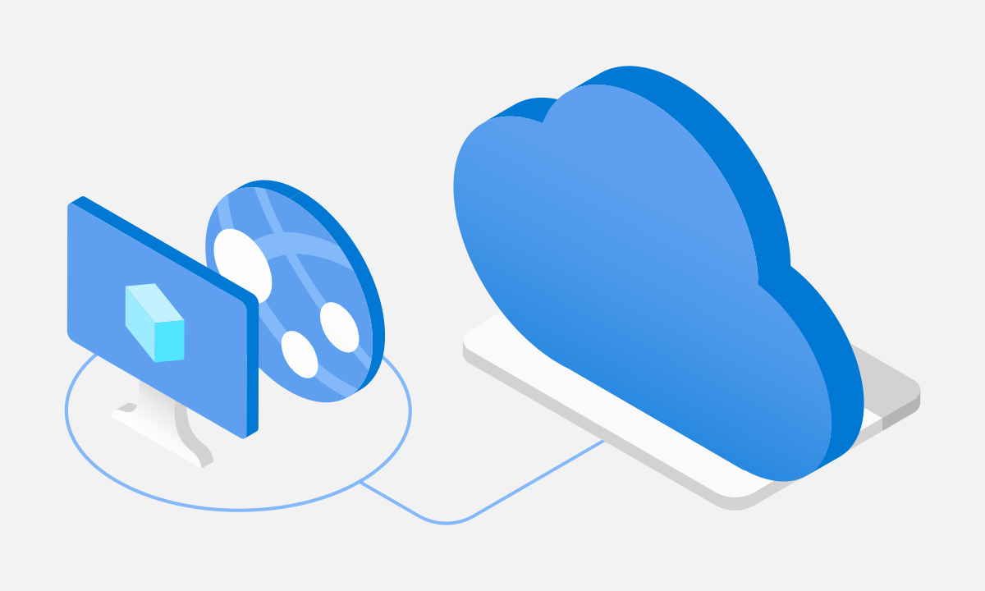
Azure Arc: … and more specifically Azure services & management capabilities on any infrastructure, anywhere
Azure Arc for servers
Azure Arc for Kubernetes
Azure data services on Azure Arc
1
2
3
Azure Arc for Servers
Azure Arc for Kubernetes
Azure data services on Azure Arc
1. Organize and govern servers across environments
Azure Arc extends Azure's management to physical and virtual servers anywhere. Govern and manage servers from a single, scalable management pane.
Learn more
2. Manage Kubernetes applications at-scale
Deploy and configure Kubernetes applications consistently across all your environments with modern DevOps techniques.
Learn more
3. Run data services anywhere
Deploy Azure data services in moments anywhere you need them. Get simpler compliance, faster response times, and better security for your data.
Learn more

Slide 119
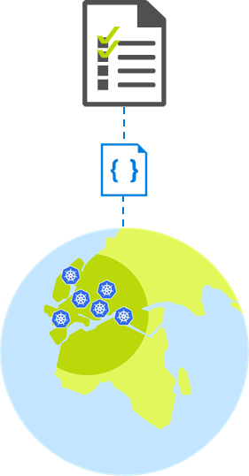
Customer scenario – At-scale Kubernetes App management
Overview
A retailer with 100s of stores would like to move all in-store applications to containers running on a K8s clusters.
They are faced with the challenge of how to uniformly deploy, configure and manage their containerized applications across multiple locations.
Business requirements
Bootstrap a new store to fully run with the applications and configuration that this store requires
Enable IT to apply and monitor at scale governance across all stores
Monitor the state of applications and configuration in all stores
Integrate DevOps and Safe Deployment Practices for applications running in stores
Allow region/store IT to monitor and troubleshoot configuration issues for their stores

Slide 120
Customer scenario - solution
Azure Management
(Azure Resource Manager, Azure Policy, Azure Portal, API, CLI…)
Key benefits from Azure Arc
Asset organization and inventory with a unified view in the Azure Portal across all locations
At scale configuration and deployment based on subscription, resource groups, and tags
GitOps-based model for deploying configuration as code to one or many clusters
Application deployment and update at scale
Source control based Safe deployment procedures when rolling new applications and configurations
Developer tooling agnostic - Use the tools they want.
Azure Arc

Slide 121
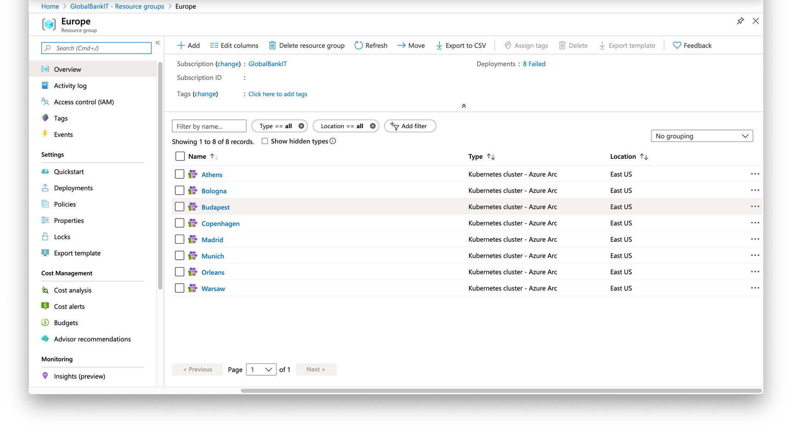

Slide 122
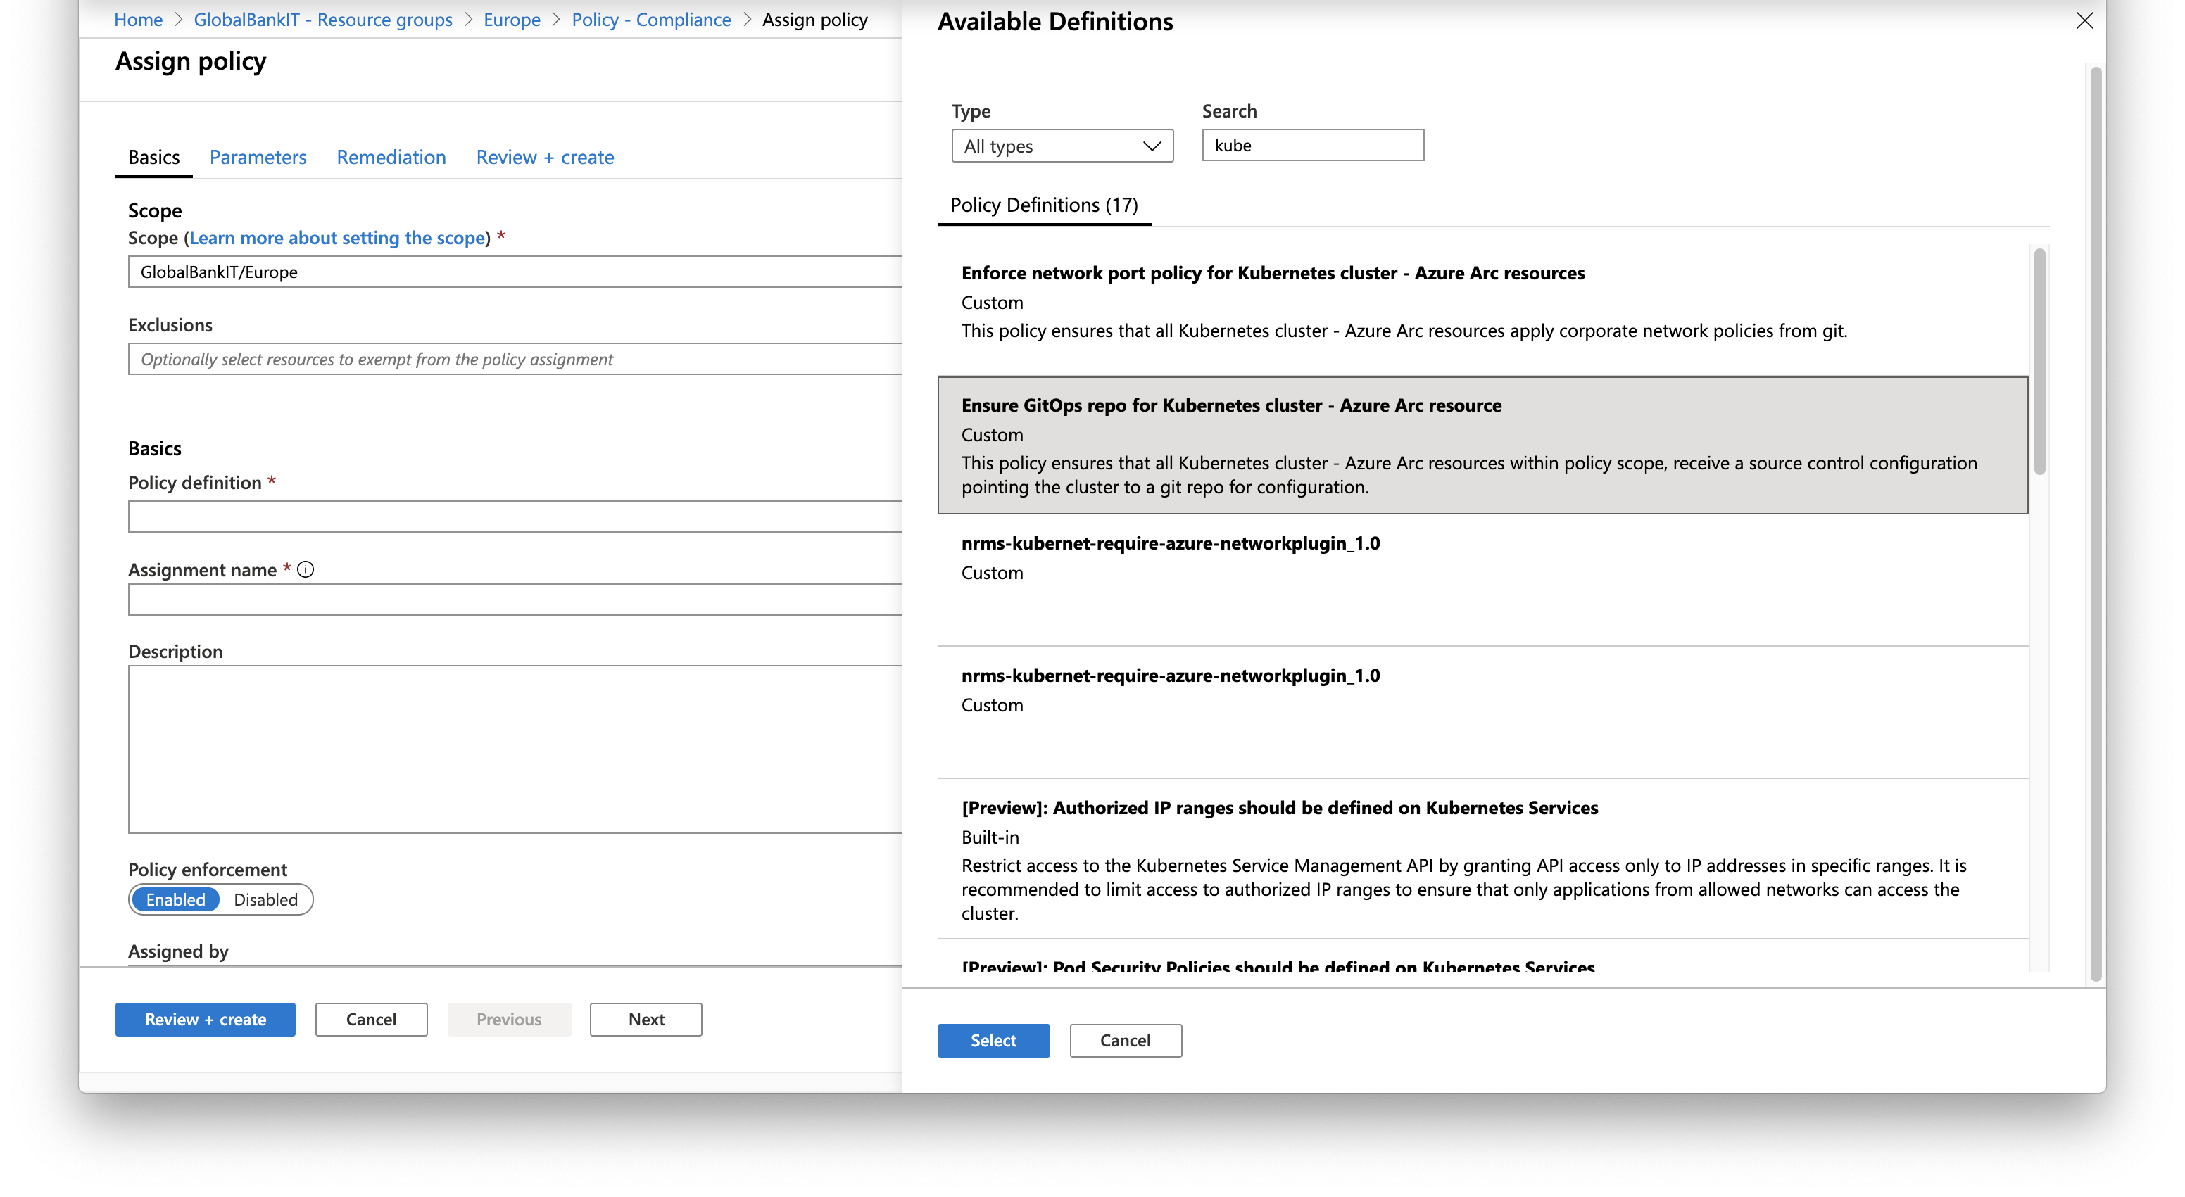

Slide 123



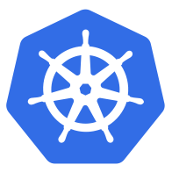
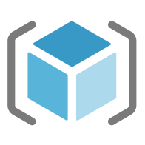


Customer scenario – Governance
Where is everything? Are they compliant?
Requirements
Manage a mix of bare metal, Windows and Linux servers
Visibility across locations, OS flavors and disparate systems
Enable IT to apply at scale governance and security policies across all servers
Enable application owners to apply and audit to meet their own requirements
Measure and remediate compliance at scale and down to the individual workload/server
Datacenter
& branch office

Slide 124
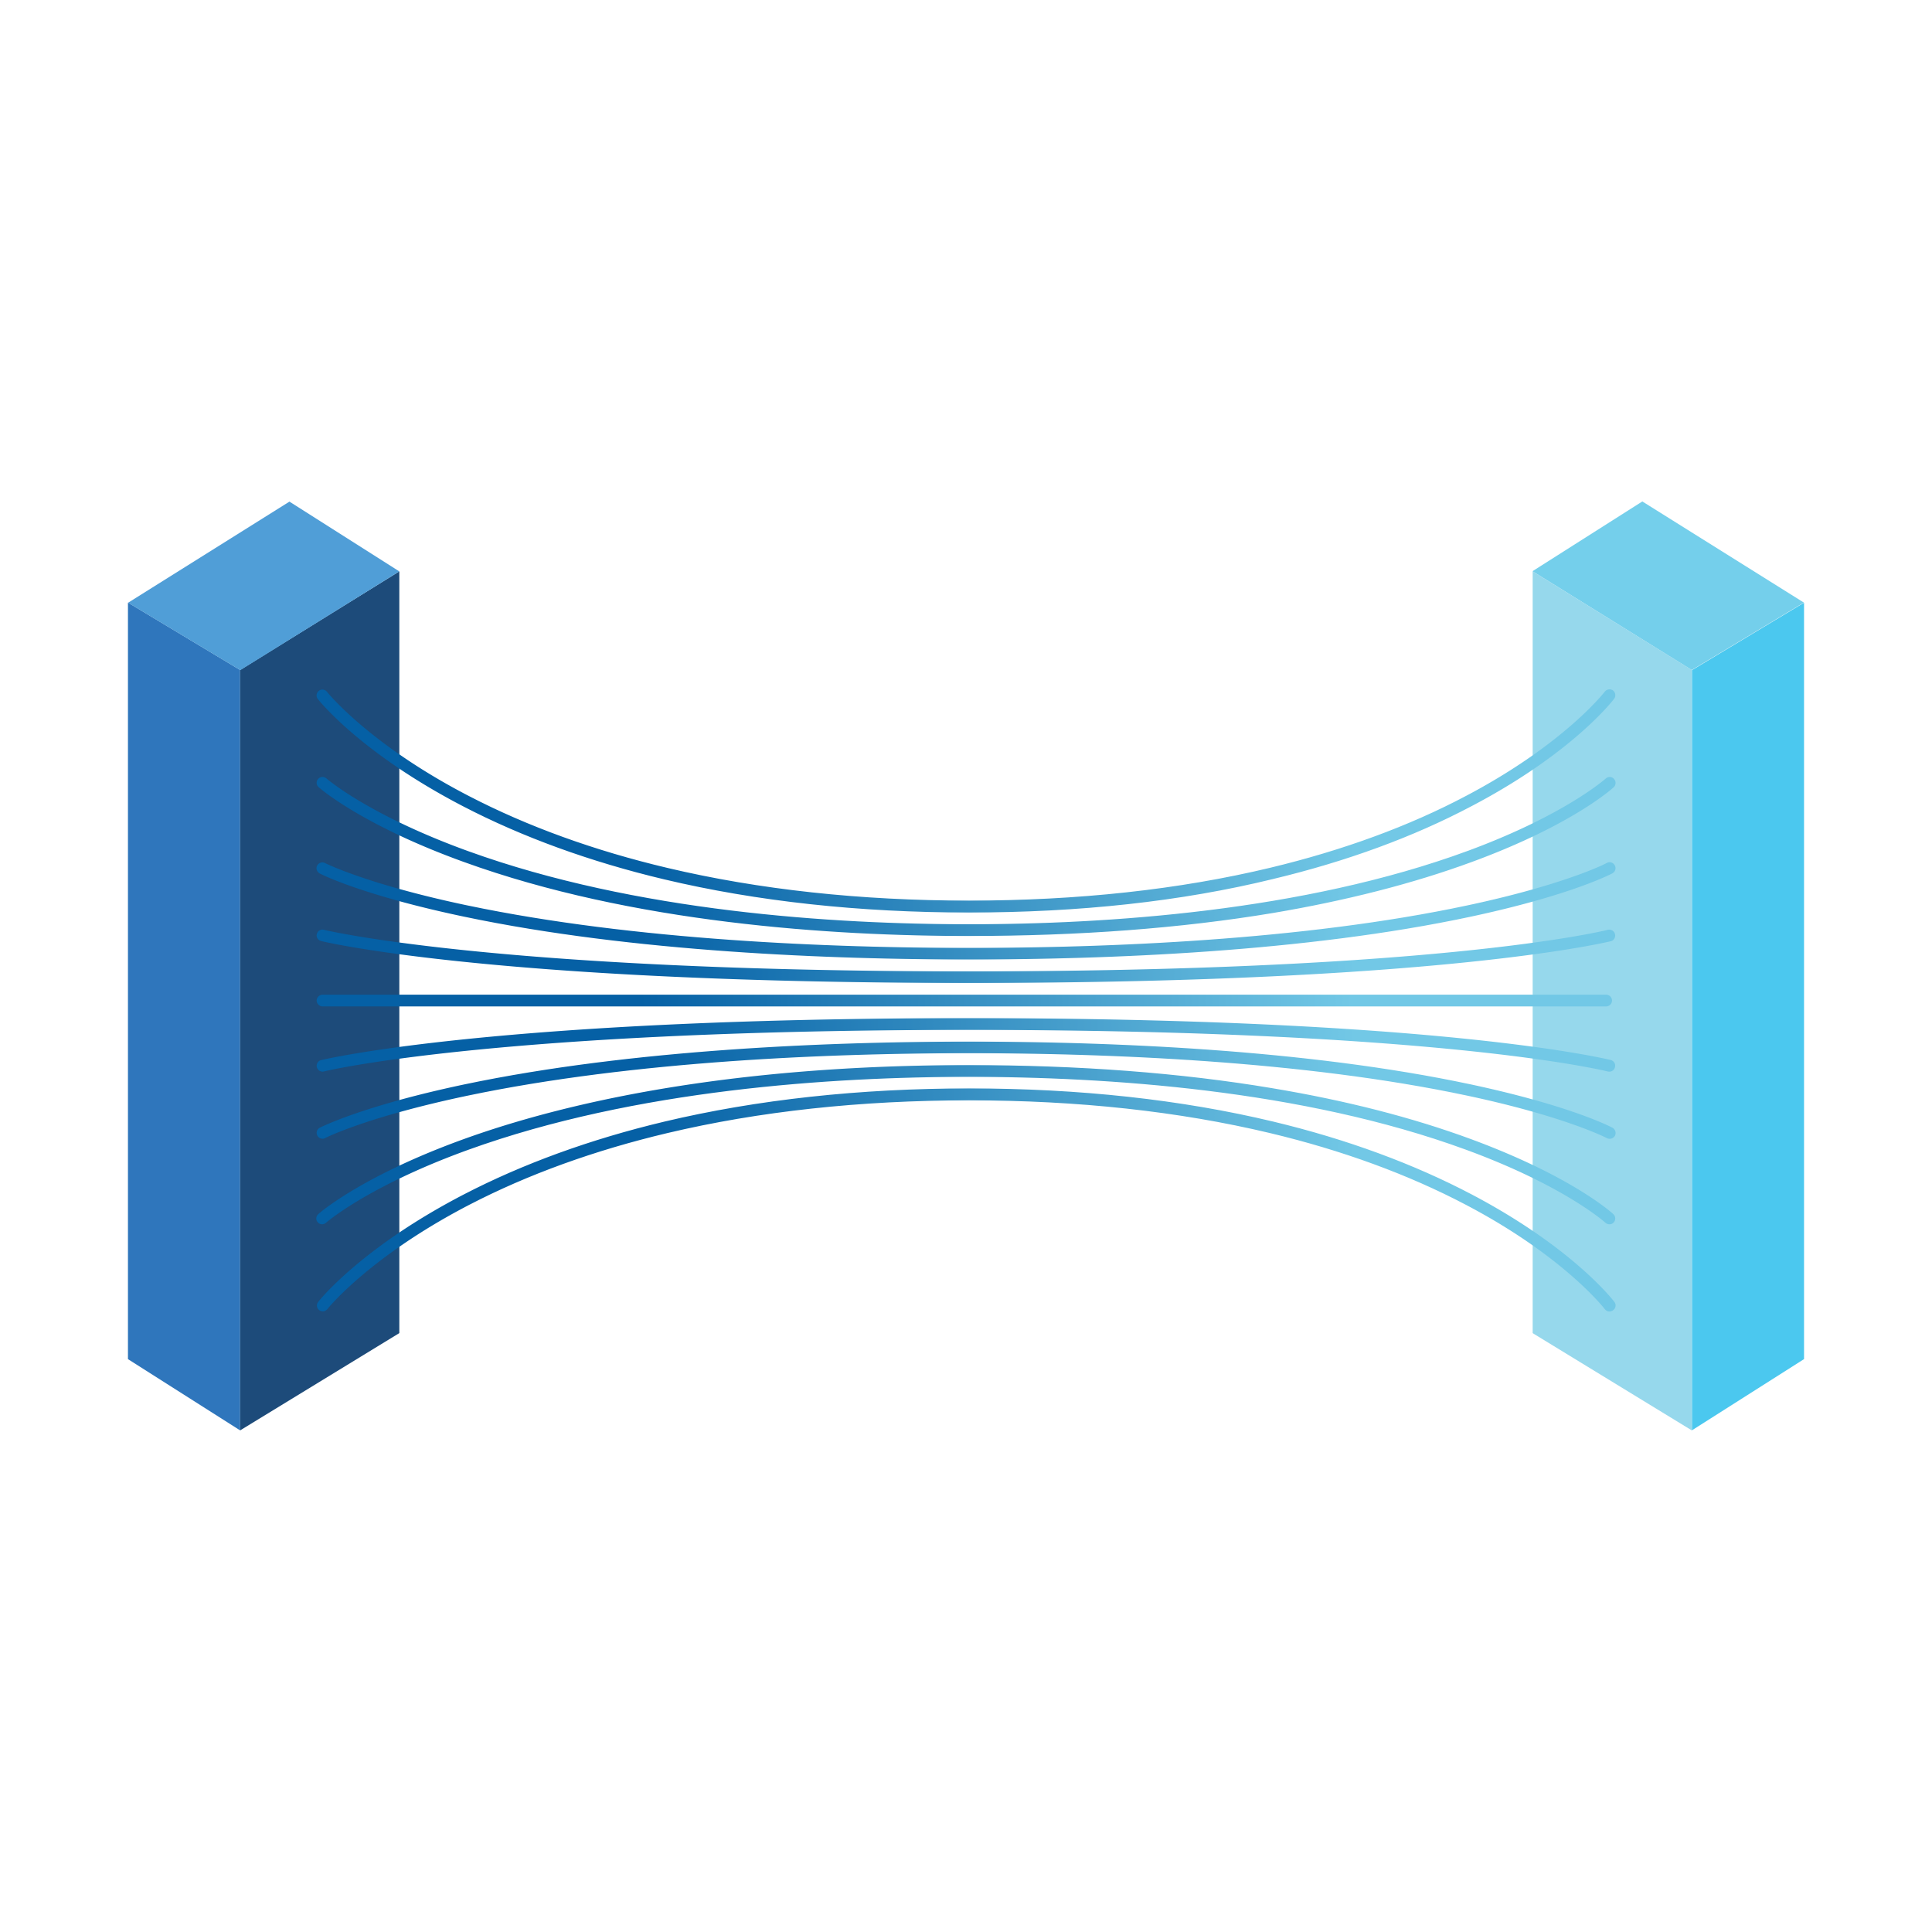



Customer scenario – Solution
Datacenter
& branch office
Central Governance across your environment
Asset organization and inventory with a unified view in the Azure Portal
Central IT creates broad governance policies
Central compliance view across all servers
Built-in server compliance rules
Server owners can view and remediate to meet their compliance
must work within those policies
can create their own
can view their compliance
Azure Arc for servers
Azure
Policy
Azure Resource Manager
Azure Arc for servers
Multi-cloud

Slide 125
Although adopters of microservices have yielded the benefits, they are also experiencing challenges in their implementation
Gets harder
Gets easier
Source: Dimensional Research, “Global Microservices Trends, A Survey of Development Professionals” (April 2018)
ResearchGate, “Challenge of Microservices Architecture: A Survey on the State of the Practice” (May 2018)

Slide 126



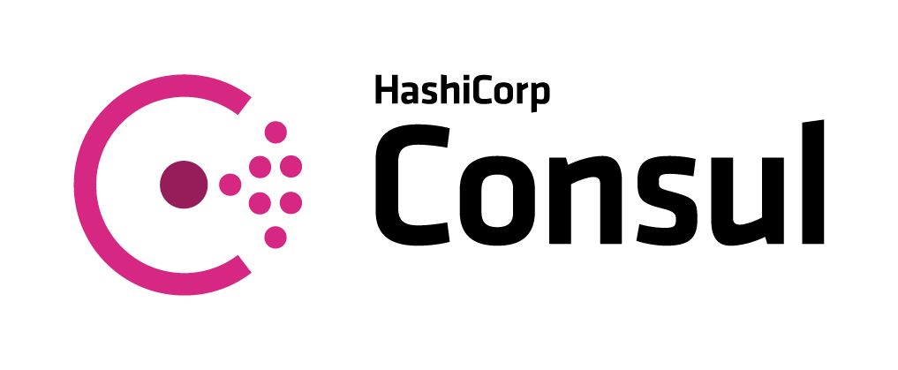

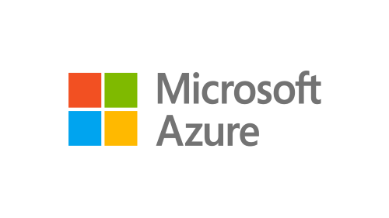
Service Mesh Interface (SMI) for Kubernetes
A Kubernetes interface that provides traffic routing, traffic telemetry, and traffic policy
Standardized
Apps
Tooling
Ecosystem
Standard interface for service mesh on Kubernetes
Simplified
Basic feature set to address most common scenarios
Service Mesh Interface
…and more
Extensible
Support for new features as they become widely available

Slide 127
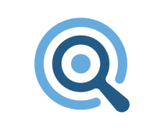
Container Security Goals and Objectives
Azure first
Focus on Azure cloud native features
Unique AKS security offering
Leverage inner visibility to AKS nodes, cloud traffic and security controls
Ease of deployment
Out-of-the-box native auto provisioned solution
Single pane of glass for CWP
Part of a cloud security suite and blends in the overall Azure and ASC experience.
AI based features, with cloud-powered intelligence
Leverages Microsoft’s security experience and expertise, and also Azure cloud power

Slide 128
Container Security feature set
Important milestone!
Azure native solution providing coverage for following of container security aspects
Vulnerability Management – scanning container images (Preview)
An essential security control, one that customers have long been expecting.
Environment Hardening
Docker configuration continuous monitoring of docker CIS benchmark (GA)
AKS cluster continuous monitoring (Preview)
Runtime protection - real-time threat detection for containerized environments (Preview)
Notes:
This is an important milestone, marking ASC’s entrance into the rapid growing Container Security space with a native solution that blends into our cloud security suite, in the journey to provide Azure customers a single pane of glass for CWP

Slide 129
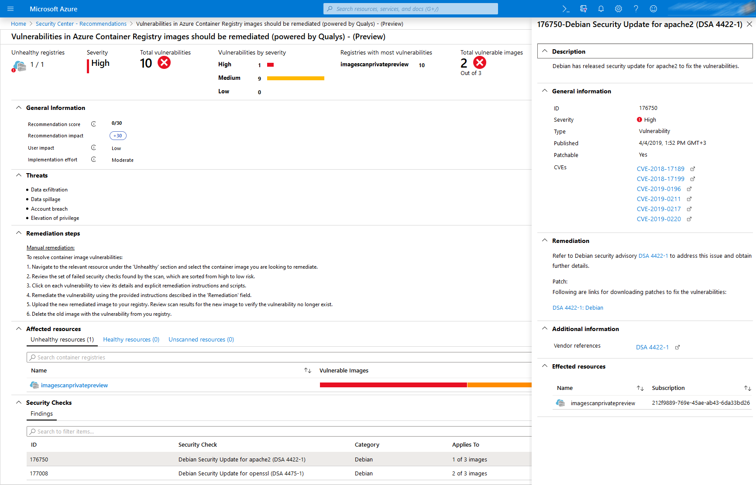
Built-in vulnerability assessment for container images
Public Preview available in standard ASC with a new Container Registries bundle
Seamless deployment and configuration of the vulnerability scanner – Qualys (a VA scanning market leader)
Scan container images for vulnerabilities upon push to an ACR
Visibility to vulnerable ACR container images including vulnerabilities details, severity classification and guidance to remediation

Slide 130
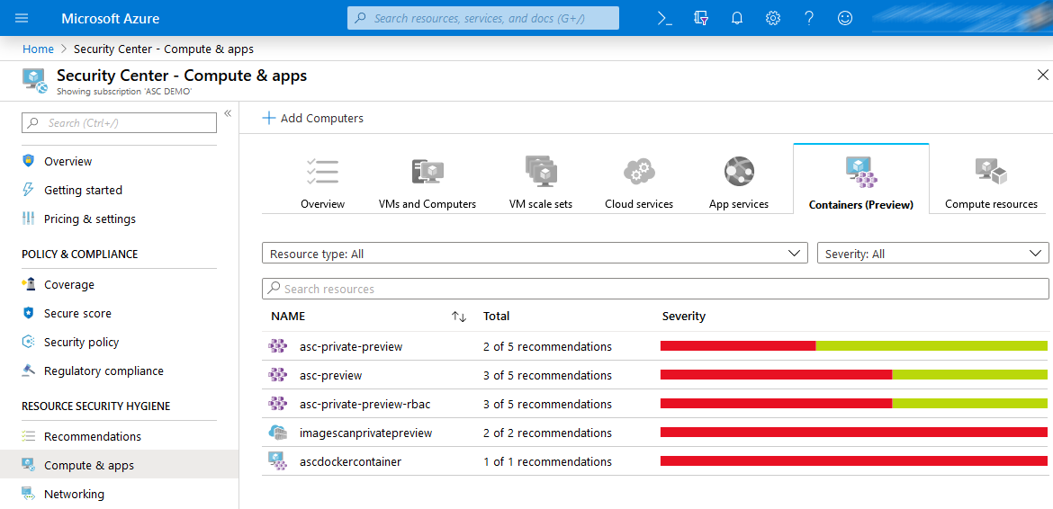
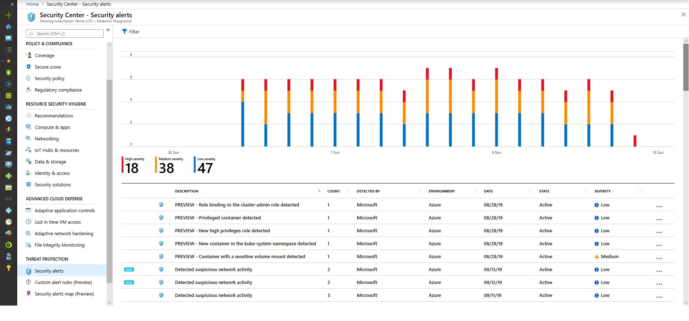
Environment hardening and Threat detection
Available in standard ASC with a new Container Service bundle
Protecting Container hosts (IaaS)
CIS Docker Benchmark assessment continuous monitoring of your Docker configuration against
Node Threat Protection
Intelligent analytics for threat detection
Protecting AKS
Actionable recommendations
based on AKS best practices and includes threat remediation
Cluster and Node Threat detection- Intelligent analytics for threat detection based on AKS audit log and Linux Auditd

Slide 131
Container host level detection- Examples
Standard
Tier
Linux based analytics
Ransomware behavior
Web shell detection
Connection with TI IPs
…
Container based analytics
Privileged container
Exposed docker daemon
SSH server running in a Container
Crypto Mining Container
Suspicious access to API server
- Continues research
- Based on Linux AuditD agent and network information analysis
Notes:
Privileged Container Detected - Machine logs indicate that a privileged Docker container is running. A privileged container has a full access to the host's resources. If compromised, an attacker can use the privileged container to gain access to the host machine.
Privileged command run in container - Machine logs indicate that a privileged command was run in a Docker container. A privileged command has extended privileges on the host machine.
Exposed Docker daemon detected - Machine logs indicate that your Docker daemon (dockerd) exposes a TCP socket. By default, Docker configuration, does not use encryption or authentication when a TCP socket is enabled. This enables full access to the Docker daemon, by anyone with access to the relevant port.
SSH server is running inside a container - Machine logs indicate that an SSH server is running inside a Docker container. While this behavior can be intentional, it frequently indicates that a container is misconfigured or breached.
Container with a miner image detected - Machine logs indicate execution of a Docker container that run an image associated with a digital currency mining. This behavior can possibly indicate that your resources are abused by an attacker.
Suspicious request to Kubernetes API - Machine logs indicate that a suspicious request was made to the Kubernetes API. The request was sent from a Kubernetes node, possibly from one of the containers running in the node. Although this behavior can be intentional, it might indicate that the node is running a compromised container.

Slide 132
AKS Cluster Level detection - Examples
New AKS
Bundle
Role binding to cluster-admin
Exposed Kubernetes dashboard
High privileges roles
Create containers in kube-system namespace
Malicious images - digital currency mining container
Privileged containers
Sensitive mounts
Kubernetes audit logs analysis
Notes:
AKS_ClusterAdminBinding - PREVIEW - Role binding to the cluster-admin role detected
Kubernetes audit log analysis detected a new binding to the cluster-admin role which gives administrator privileges. Unnecessary administrator privileges might cause privilege escalation in the cluster.
AKS_ExposedDashboard - PREVIEW - Exposed Kubernetes dashboard detected
Kubernetes audit log analysis detected exposure of the Kubernetes Dashboard by a LoadBalancer service. Exposed dashboard allows an unauthenticated access to the cluster management and poses a security threat.
AKS_HighPrivilegesRole - PREVIEW - New high privileges role detected
Kubernetes audit log analysis detected a new role with high privileges. A binding to a role with high privileges gives the user\group high privileges in the cluster. Unnecessary privileges might cause privilege escalation in the cluster.
AKS_KubeSystemContainer - PREVIEW - New container in the kube-system namespace detected
Kubernetes audit log analysis detected a new container in the kube-system namespace that isn’t among the containers that normally run in this namespace. The kube-system namespaces should not contain user resources. Attackers can use this namespace for hiding malicious components.
AKS_MaliciousContainerImage - PREVIEW - Digital currency mining container detected
Kubernetes audit log analysis detected a container that has an image associated with a digital currency mining tool.
AKS_PrivilegedContainer - PREVIEW - Privileged container detected
Kubernetes audit log analysis detected a new privileged container. A privileged container has access to the node’s resources and breaks the isolation between containers. If compromised, an attacker can use the privileged container to gain access to the node.
AKS_SensitiveMount - PREVIEW - Container with a sensitive volume mount detected
Kubernetes audit log analysis detected a new container with a sensitive volume mount. The volume that was detected is a hostPath type which mounts a sensitive file or folder from the node to the container. If the container gets compromised, the attacker can use this mount for gaining access to the node.

Slide 133
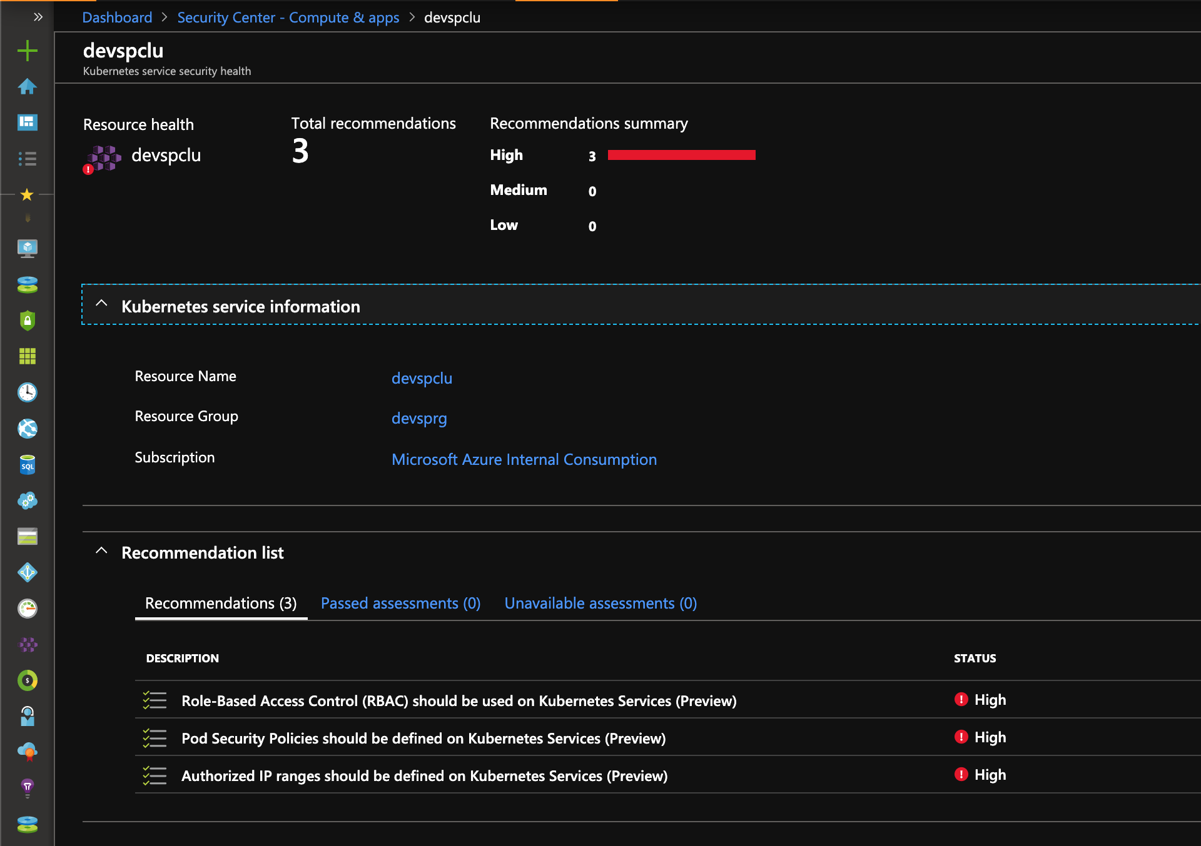
Recommendations based upon security controls enabled in AKS

Slide 134
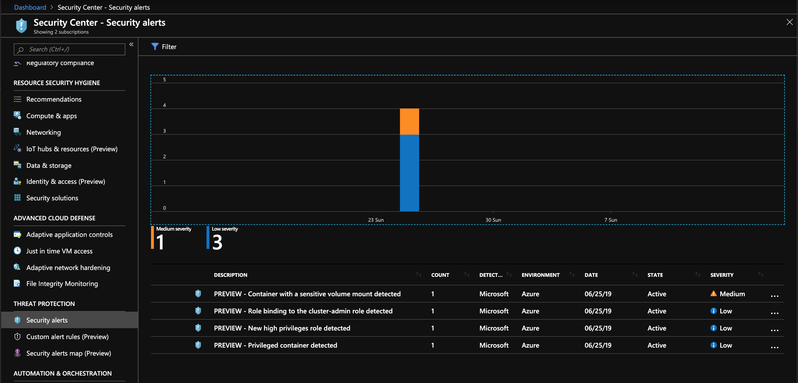
Recommendations based upon audit log analysis

Slide 135
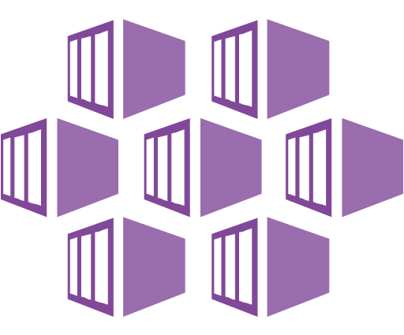
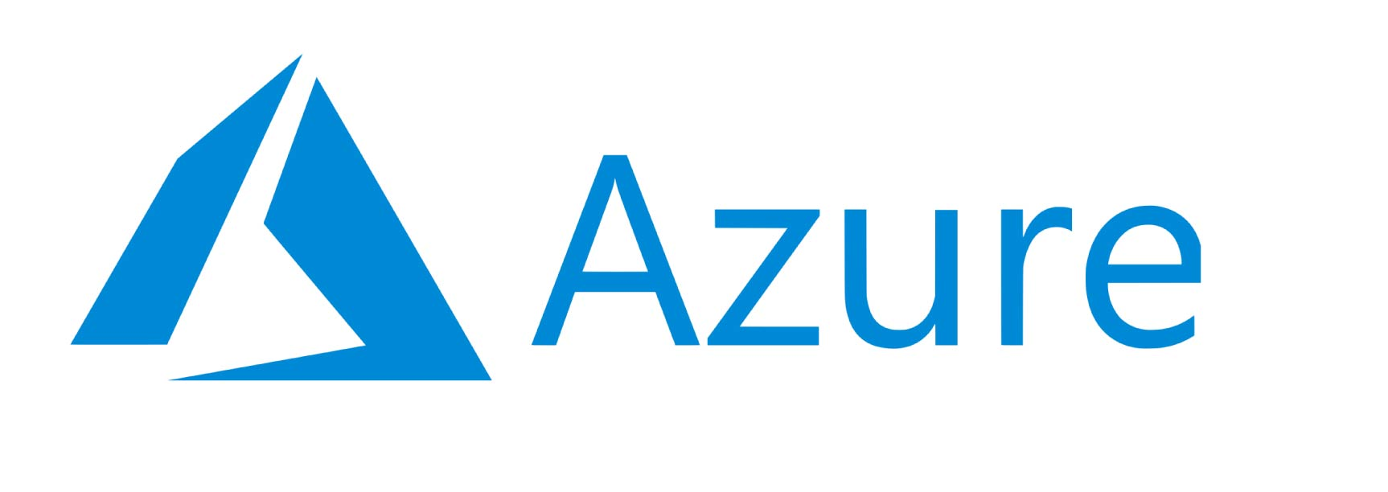




Protecting against advanced cloud threats
Master Node
Recommending to use RBAC on K8s
API Server
Azure VM
Node 1
Node 2
Node 3
Container
Vulnerable application
Container
Container
Container
Azure VM
Azure VM
Azure VM

Slide 136
Protecting against advanced cloud threats
Master Node
Recommending to use RBAC on K8s
API Server
Exploit
Azure VM
1
Node 1
Node 2
Node 3
Container
Vulnerable application
Container
Container
Container
Azure VM
Azure VM
Azure VM

Slide 137
Protecting against advanced cloud threats
Master Node
Recommending to use RBAC on K8s
API Server
Exploit
Azure VM
1
2
API request (deploy container)
Node 1
Node 2
Node 3
Container
Vulnerable application
Container
Container
Container
Azure VM
Azure VM
Azure VM

Slide 138

Protecting against advanced cloud threats
Master Node
Recommending to use RBAC on K8s
Detects suspicious request to K8s API
API Server
Exploit
Azure VM
1
2
API request (deploy container)
Node 1
Node 2
Node 3
Container
Vulnerable application
Container
Container
Container
Azure VM
Azure VM
Azure VM

Slide 139
Protecting against advanced cloud threats
Master Node
Recommending to use RBAC on K8s
Detects suspicious request to K8s API
API Server
Exploit
Azure VM
1
2
API request (deploy container)
3
Node 1
Node 2
Node 3
Container
Vulnerable application
Malicious container
Container
Container
Container
Azure VM
Azure VM
Azure VM

Slide 140
Protecting against advanced cloud threats
Master Node
Recommending to use RBAC on K8s
Azure VM
Detects privileged container
API Server
Detects crypto mining image
Detects sensitive volume mount
Exploit
1
2
API request (deploy container)
3
Privileged w/ crypto miner & root access to Node 3
Node 1
Node 2
Node 3
Container
Vulnerable application
Malicious container
Container
Container
Container
Azure VM
Azure VM
Azure VM

Slide 141

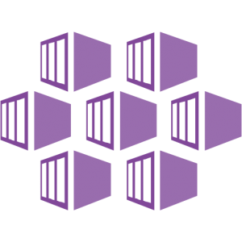
AKS Support in Azure Security Center
1
Continuous discovery of managed AKS instances
Capabilities
Seamless Azure native solution through Security Center
For managed subscriptions, each new AKS cluster and node are discovered in Azure Security Center.
Security Center monitor AKS cluster for security misconfigurations and provides actionable recommendations for compliance with security best practices.
Security Center continuously analyzes AKS for potential threats based on:
Raw security events such as network data and process creation
Kubernetes audit log
and reports any threats and malicious activity detected e.g. “API requests to your cluster from a suspicious IP was detected”
`
2
Actionable recommendations for security best practices
Azure Security Center
3.2
Detect threats across AKS nodes and clusters using advanced analytics
3.1
Azure Kubernetes Service Cluster
Raw
Security
Events
Audit Log
AKS Security Configuration
Verified by Security Center
Master
Workers
Node 1
Node 2
Node 3
API Server
Container Runtime
Container Runtime
Container Runtime
Security Center
Security Center
Security Center
Notes:
Kubernetes is quickly becoming the new standard for deploying and managing software in the cloud. Few people have extensive experience with Kubernetes and many only focuses on general engineering and administration and overlook the security aspect. Kubernetes environment needs to be configured carefully to be secure, making sure container doors are not left open for attackers. Security Center is expanding its support in the container space to one of the latest growing services in Azure - Azure Kubernetes Service (AKS). The new capabilities in this public preview release include:
Discovery & Visibility - Continuous discovery of managed AKS instances within Security Center’s registered subscriptions.
Recommendations - Actionable items to help customers in complying to security best practices in AKS, such as "Role-Based Access Control should be used to restrict access to a Kubernetes Service Cluster"
Threat Detection - Host and cluster-based analytics
The new capabilities help create awareness and guidance towards security best practices for configuring AKS hosts and orchestration; harden AKS hosts and orchestration, proactively protects from a security breach within a containerized application and blends consistently with the Security Center experience.

Slide 142

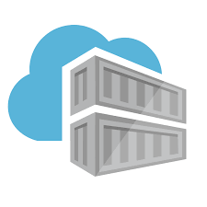
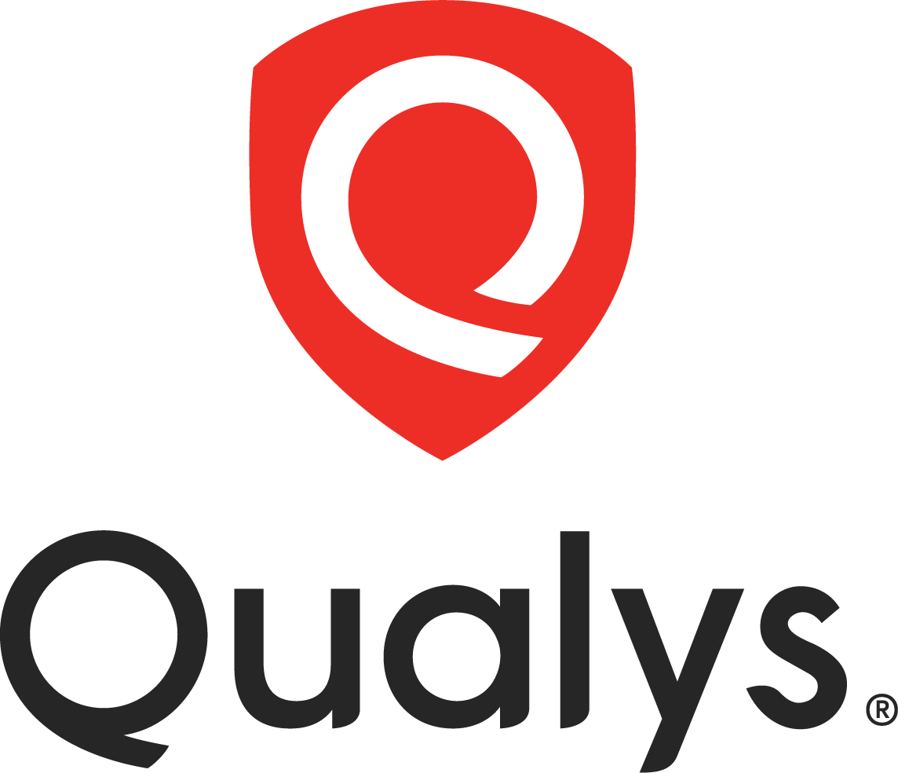
ACR Support in Azure Security Center
Discovery of Vulnerable ACR container images
2
Capabilities
3
Actionable recommendations
Seamless native solution through Security Center
For registered subscriptions, when an image is pushed to an ACR, Security Center scans the image for vulnerabilities utilizing Qualys - a VA scanning market leader
Scanned ACR registries are discovered in Azure Security Center dashboard.
Security Center provides actionable recommendations for images with known vulnerabilities
Security Center provides details for each reported vulnerability along with severity classification and guidance to remediation
Azure Security Center
4
Vulnerabilities details with severity classification
Push container image
CI/CD
Azure Region
Web hook
Azure Container Registry
Azure Container Registry
Azure Container Registry
Azure Security Center
Scanned by Security Center
Vulnerability scanning
1

Slide 143
Wrapping Up & Next Steps

Slide 144
Workshop Goals
Secure setup of AKS in Azure
How to apply Organizations’ Governance + Security Controls to AKS
Automation of Infrastructure, Changes & App Deployment
Understand Guidance around Running Apps Securely
Integration patterns using Service Mesh

Slide 145
AKS Setup Before

Slide 146
AKS Setup After

Slide 147


Security overview
Internal User
External User
͏Image and container level security
AAD authenticated Container registry access
ACR image scanning and content trust for image validation
Azure Container Registry
App Gateway
AKS with RBAC
͏Node and cluster level security
Automatic security patching nightly
Nodes deployed in private virtual network subnet w/o public addresses
Network policy to secure communication paths between namespaces (and nodes)
Pod Security Policies
K8s RBAC and AAD for authentication
Control egress traffic for AKS cluster odes
1
Internal Load Balancer
External Load Balancer
Azure VNet
Developer
Kubernetes Admin
Active Directory
Ingress Controller
Ingress Controller
External DNS
͏Pod level security
Pod level control using AAD Pod Identity
Pod Security Context
Node
Node
Pod
Pod
͏Workload level security
Azure Role-based Access Control (RBAC) & security policy groups
Secure access to resources & services (e.g. Azure Key Vault) via Pod Identity
Storage Encryption
App Gateway with WAF to protect against threats and intrusions
Traffic management, resiliency, policy, security, strong identity, and observability to the workloads with Service Mesh
3
2
AAD Pod Identity
Azure Key Vault
4
Azure Storage
SQL Database
Cosmos DB
Encrypted Storage

Slide 148
Security Decisions
Decision required
Azure AAD | RBAC using AAD? Roles and cluster roles definition? Required AAD server and client applications required by AKS AAD integration? Is AAD B2B required to integrate federated or external tenants? Is ACR authentication/authorization configured?
Pod Identity | Where Pod identity will be required? What Azure services will Pods access?
Secret Management | What Secret management solution is used. Azure keyvault, vault, etc
Access to Cluster | Using bastion server?
Container Image | Signing(Content-trust) Image Security (Palo Alto Prisma-Twistlock, AquaSec, etc)
Policy Enforcement | Open Policy Agent Azure Policy
Upgrades | Cluster upgrade and Node upgrade(patching)

Slide 149
Summary
Use AKS Advanced networking for seamless integration with your VNET
Use Ingress and Ingress controllers for HTTP and HTTPs services
Use Azure Application Gateway or any other alternative from the Azure Market place to secure your services using a WAF
Use NVA like Azure Firewall to control Egress
Use Bastion Hosts to access your nodes when needed
Integrate with Azure AD for RBAC, it’s the same way we secure access to Azure
Manage Service Principals by remembering to rotate the keys (hint: moving to MSI)
Don’t forget about Patching, Nodes & AKS
Maintain good Container Image hygiene so as not to deploy non-compliant or risky images to the Cluster
Reduce Secrets mgmt by leveraging Azure AD Pod Identities (Managed Pod Identities)

Slide 150
Key Takeaways
Focus on security is a must in any Kubernetes deployment.
Help educate Security Teams on how to extend Kubernetes to integrate custom policies.
Treat the Kubernetes cluster as immutable, just like you do with applications.
Multiple ways to accomplish policy
Build all your own logic and utilize dynamic admission control
Utilize Open Policy Agent to simplify deployment and logic for rule sets.

Slide 151
Questions
Overall feedback?
What’s missing?
Worthwhile?
What would you like to see next?

Slide 152
Q & A

Slide 153
Pop Quiz #1
Applying an Azure Firewall in front of the AKS cluster to limit egress traffic will help me prevent pods in a cluster from interacting with each other
True
False
B) False

Slide 154
Pop Quiz #2
Applying specific CIDR ranges to access the API server keeps the traffic between the API server and node pool private?
True
False
B) False

Slide 155
Pop Quiz #3
I can perform actions in the Azure Security Center to remediate recommendations?
True
False
B) True?

